Slide 1

Understanding the
Safety Data Sheet (SDS)
Notes:
Slide Show Notes
Today we’re going to tell you about the Globally Harmonized System (GHS) for Classification and Labeling of Chemicals. Primarily, though, we’re going to introduce you to the safety data sheet, or SDS, that has been created by the GHS to replace the existing material safety data sheet, which you probably know as the MSDS. We’ll go through the SDS section by section so that you can learn about all the safety, health, and environmental information addressed by this important document, and so that you’ll know where to find the specific information you need for any hazardous chemical product.

Slide 2

Session Objectives
Understand the GHS and how it affects hazard communication in the workplace
Recognize how the SDS improves
your access to vital safety, health, and environmental information about chemicals in the workplace
Identify the 16 sections of the SDS and the information contained in each section
Notes:
Slide Show Notes
The main objective of this session is to describe the purpose of the GHS and introduce you to the SDS. By the time the session is over, you should be able to:
Understand the GHS and how it affects hazard communication in the workplace;
Recognize how the SDS improves your access to vital safety, health, and environmental information about chemicals used in the workplace; and
Identify the 16 sections of the SDS and the information contained in each section.

Slide 3



Prequiz:
How Much Do You Know?
Under the GHS, OSHA will no longer regulate workplace hazardous chemicals
The SDS contains less information than the old MSDS
The SDS can create a safer work environment for you and your
co-workers
The SDS will be harder to understand than the MSDS
© BLR®—Business & Legal Resources 1203
Notes:
Slide Show Notes
Before we begin the session, let’s take a few minutes to see how much you already know about the GHS and the SDS. Decide whether each statement on the screen is true or false.
Under the GHS, OSHA will no longer regulate workplace hazardous chemicals.
This is false.
The SDS contains less information than the old MSDS.
This is false.
The SDS will help to create a safer work environment for you and your co-workers.
This is true.
The SDS will be harder to understand than the MSDS.
This is false.
How did you do? Did you get all the answers right?
If not, don’t worry. You’ll learn all about these issues and a lot more during the session.

Slide 4

What Is the GHS?
  Globally Harmonized System of Classification and Labeling of Chemicals
  Implemented through HazCom
  Provides a universal approach
  Includes new labels
  and SDSs
  “Substance” and “mixture”
© BLR®—Business & Legal Resources 1203
Notes:
Slide Show Notes
OSHA’s hazard communication standard, or HazCom, requires us to tell you about hazards in the workplace. Two key ways we do that is with labels on chemical containers and the SDS (formerly MSDS). The MSDS has been an essential part of basic safety in the workplace for decades. But because of the global economy, a system is needed to standardize safety, health, and environmental information about substances so that people all over the world get the same hazard information. That system is called the GHS.
The GHS itself is not a regulation or a standard. OSHA will implement the GHS system through our own HazCom and continue to regulate chemical safety in this country.
The purpose of the GHS is to provide a universal approach to defining hazards, classifying substances, and communicating hazard information and protective measures to employers and employees throughout the United States and the world.
Among the major changes created by the GHS are new labels and a uniform SDS, which will replace the old MSDS. Today, we’ll focus on the SDS. The new GHS labels will be the subject of an upcoming training session.
Under the GHS, a “substance” is defined as a chemical element and its compounds in the natural state or obtained by any production process, including any additive necessary to preserve the stability of the product (and any impurities deriving from the process used, but excluding any solvent that may be separated without affecting the stability of the substance or changing its composition). “Mixtures” are defined as mixtures or solutions composed of two or more substances in which they do not react.

Slide 5

The Benefits of
The GHS and SDS
  Improved workplace safety
  Fewer exposures
  Consistent communications
  Greater hazard awareness
  Easier compliance
  Enhanced human and environmental protection
© BLR®—Business & Legal Resources 1203
Notes:
Slide Show Notes
The basic goal of hazard communication is to ensure that employers and employees are provided with adequate practical, reliable, and comprehensible information on the hazards in the workplace so that they can take effective preventive and protective measures for their health and safety.
Implementation of the GHS and the use of the SDS are expected to:
Create a safer work environment for you and your co-workers;
Reduce workplace accidents and illnesses caused by workplace exposures in the United States and around the world;
Provide consistent and simplified communications about substances and safe work practices;
Create greater awareness of hazards, resulting in safer use of substances in the workplace;
Make it easier and less costly to comply with hazard communication regulations; and
Enhance the universal protection of human health and the environment.

Slide 6

The Difference Between
An SDS and an MSDS?
  Organization
  Information
  Detail
  Sections
© BLR®—Business & Legal Resources 1203
Notes:
Slide Show Notes
The purpose of both the old MSDS and the SDS is the same—to provide safety and health information about chemicals to help prevent accidents and exposures. Primary differences between the two documents include how they’re organized, the information included, the degree of detail presented, and the number and content of sections.
If you’ve been using MSDSs that follow the American National Standards Institute, or ANSI, format, the SDS will look similar and contain basically the same information. You will, however, find some additional information and a few differences in where and how information is presented in the SDS.
If you’re more familiar with the other MSDS formats, you’ll find greater differences when you consult the SDS. But the changes will be positive. The SDS will be no harder to work with and understand than the old MSDS, but it will give you access to more complete information about the chemicals you use. This means you’ll be able to work more safely and protect your health.
During this session you’ll learn all about the SDS, its 16 sections, and the information contained in each section. Let’s get started now and look at the first section of the SDS.

Slide 7

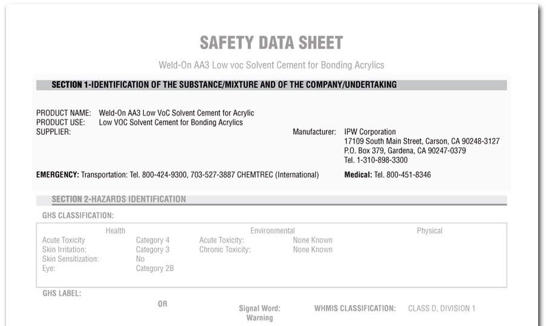
Identification of Substance and Supplier
SECTION 1:
Identification of
Substance and Supplier
© BLR®—Business & Legal Resources 1203
Notes:
Slide Show Notes
The first section of the SDS identifies the chemical or mixture as well as the manufacturer or distributor. The information you’ll find in this section includes:
The product identifier used on the label and other means of identification;
Recommended use of the chemical and restrictions on use;
Information about the supplier of the chemical, including name, address, and phone number; and
An emergency phone number for obtaining information about spills and other accidents 24 hours a day, 7 days a week.
Properly identifying a product and its recommended uses is an important part of working safely with the chemical. Information about the supplier and an emergency number is critical, especially in the event of an accident involving the product.

Slide 8
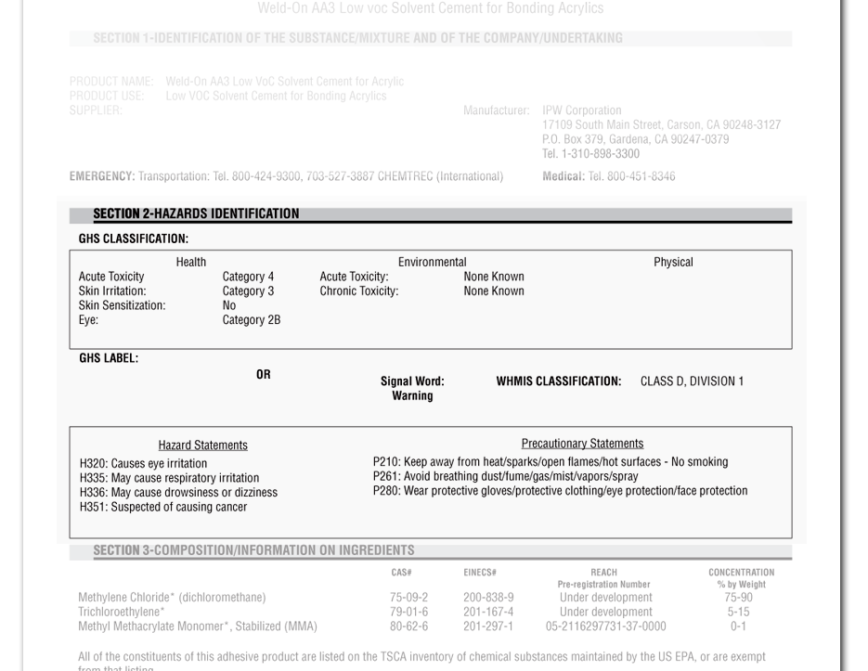
Hazards Identification
SECTION 2:
© BLR®—Business & Legal Resources 1203
Notes:
Slide Show Notes
The second section of the SDS identifies hazards of the chemical or mixture. This section includes the following information.
The hazard classification of the chemical or mixture and any national or regional information is provided. Hazard classifications include physical hazards such as flammable or reactive, health hazards such as toxic or cancer-causing, and environmental hazards such as hazards posed to an aquatic environment.
Signal word, including hazard and precautionary statements, are also given in this section. Hazard symbols may be provided graphically—for example, with a flame or a skull and crossbones symbol—or by name.
Other hazards not otherwise classified.
Any statements regarding mixtures consisting of ingredients of unknown toxicity.
Think about how important it is to identify the hazards of the substances you work with. Consulting this section helps you understand the risks of knowing the hazards associated with the substances in the workplace.
Emphasize the importance of knowing chemical hazards, which is one of the main reasons for consulting the SDS.

Slide 9
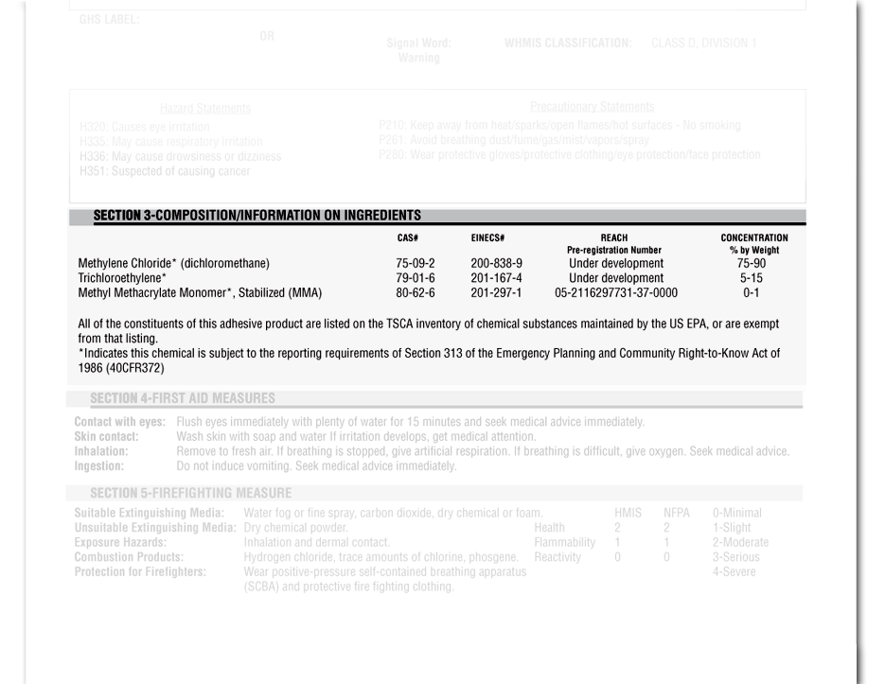
Composition and Information
On Ingredients
SECTION 3:
© BLR®—Business & Legal Resources 1203
Notes:
Slide Show Notes
Information about chemical composition and ingredients is provided in Section 3.The section provides information relevant to both substances and mixtures.
For substances, this information includes:
- Chemical name;
- Common name and synonyms;
Chemical Abstract Service, or CAS, number, and other unique identifiers; and
Impurities and stabilizing additives that are themselves classified and that contribute to the classification of the substance.
For mixtures, the information provided in this section indicates the chemical name and concentration, or concentration ranges, of all ingredients that are classified as health hazards and that are present above their cutoff limits or present a health risk below their cutoff limits.

Slide 10
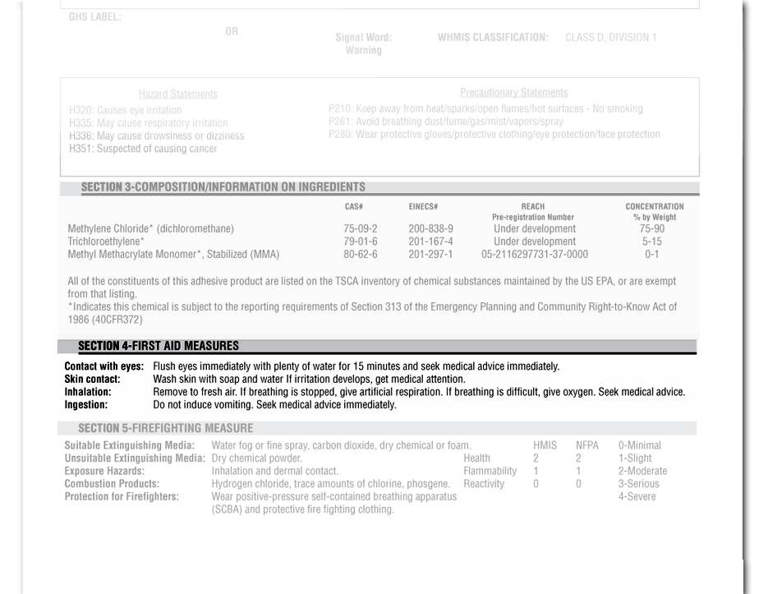
First-Aid Measures
SECTION 4:
© BLR®—Business & Legal Resources 1203
Notes:
SSlide Show Notes
Like the old MSDS, the SDS addresses first aid for exposures.
In Section 4, you will find:
- A description of necessary first-aid measures categorized, to the different routes of exposure—inhalation, skin and eye contact, and ingestion;
- The most important symptoms and health effects, both acute and delayed; and
- The need for immediate medical attention and special treatment when required.
It’s important to know proper first aid for exposures. Whether it’s you or a co-worker who is exposed to a substance, quick, effective, on-the-spot treatment greatly increases the chance of a full recovery.
Ask how many trainees have taken a first-aid course. Provide trainees with a list of personnel who are certified first-aid providers.

Slide 11



Exercise
True or False?
The GHS replaces the current HazCom
in the U.S.
The GHS is a worldwide system for promoting the safe use of substances
in the workplace
The use of the SDS is optional
The SDS will generally contain more complete information than the MSDS
The GHS and SDS are expected
to reduce workplace accidents
and exposures
Notes:
11
Slide Show Notes
Now let’s try a true/false exercise to test your knowledge of the information presented in the previous slides.
The GHS replaces the current HazCom in the United States
This is false.
The GHS is a worldwide system for promoting the safe use of substances in the workplace.
This is true.
The use of the SDS is optional.
This is false. The SDS format will be mandatory after a phase-in period.
The SDS will generally contain more complete information than
the MSDS.
This is true.
The GHS and SDS are expected to reduce workplace accidents
and exposures.
This is true.
How did you do? Were you able to identify all the true statements?

Slide 12

Review
Do you understand:
  Purpose of the GHS?
  Benefits of the GHS and the SDS?
  Differences between the SDS and MSDS?
  Sections 1–4 of the SDS?
Notes:
Slide Show Notes
Now it’s time to ask yourself if you understand the information that has been presented so far. For example, do you understand what we’ve said about:
The purpose of the GHS?
The benefits of the GHS and the SDS?
The differences between the SDS and the old MSDS?
Sections 1 through 4 of the SDS?
All this information will help you understand and work with the SDS that forms a critical part of the GHS and OSHA’s HazCom.
Answer any questions trainees have about the information presented in the previous slides.
Conduct an exercise, if appropriate.
Let’s continue now to the next slide and talk about Section 5 of the SDS.

Slide 13
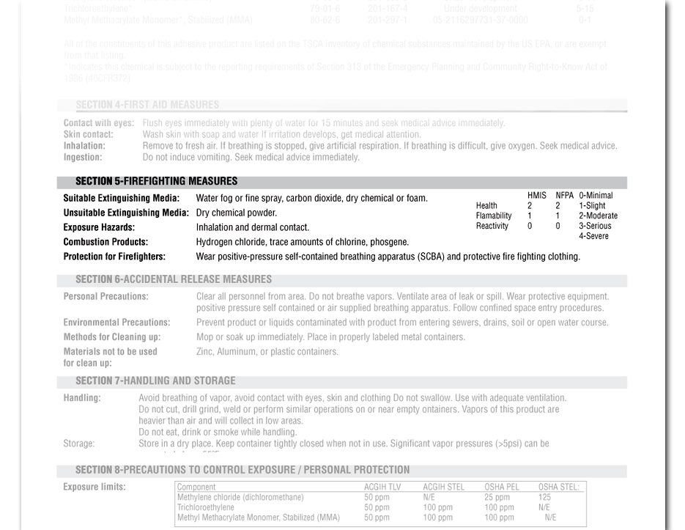
Fire-Fighting Measures
SECTION 5:
© BLR®—Business & Legal Resources 1203
Notes:
Slide Show Notes
Section 5 contains information about fighting fires caused by the substance. This section includes:
Suitable and unsuitable extinguishing substances—for example, not using water on a substance that reacts with water;
Specific hazards arising from the chemical—for example, nature of any hazardous vapors released when the chemical is heated, used, or burned; and
Special personal protective equipment and precautions for firefighters.
Do you know the proper procedure for reporting and responding to workplace fires, specifically to fires caused by substances that can create hazardous situations?
Discuss procedures for reporting and responding to workplace fires in general, and specifically to fires caused by substances.

Slide 14
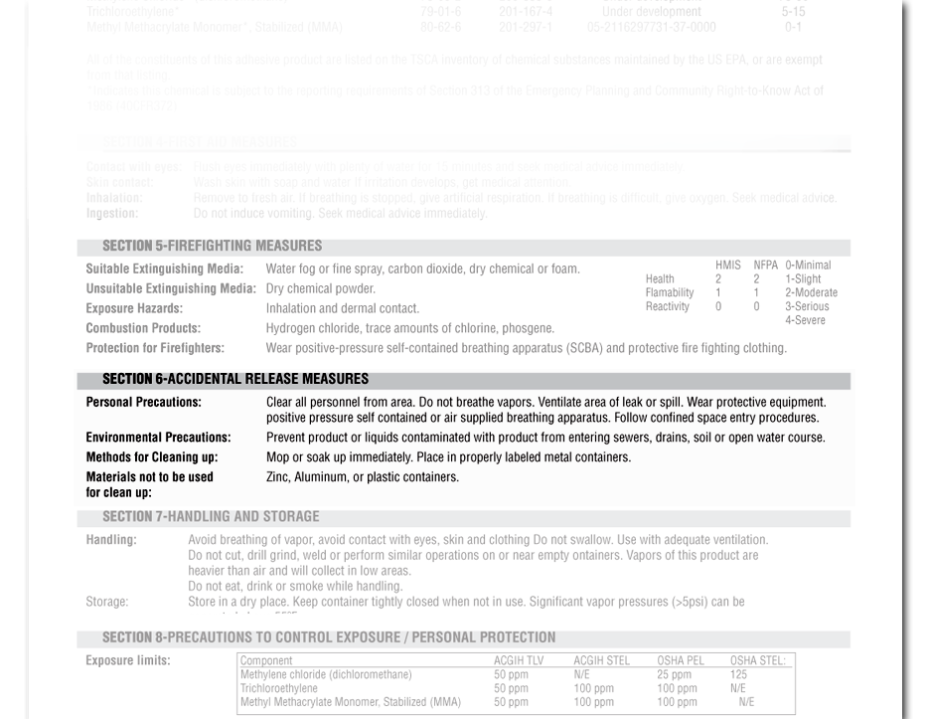
Accidental Release Measures
SECTION 6:
© BLR®—Business & Legal Resources 1203
Notes:
Slide Show Notes
Section 6 tells you what to do in the event of an accidental release.
For example, it outlines:
- Personal precautions and personal protective equipment;
- Emergency precautions;
- Environmental procedures; and
- Methods and materials of containment and cleanup.
Do you know the procedure for reporting and responding to spills and releases?
Discuss procedures for reporting and responding to chemical releases, including identifying those responsible for containment and cleanup.

Slide 15
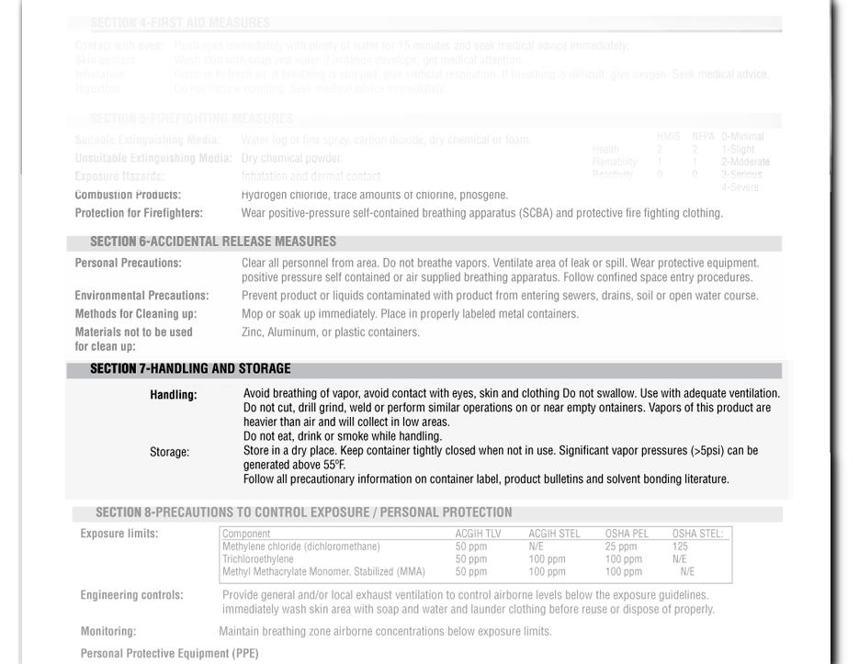
Handling and Storage
SECTION 7:
© BLR®—Business & Legal Resources 1203
Notes:
Slide Show Notes
In Section 7 you’ll learn about safe handling and storage requirements, including:
Precautions for safe handling of the substance; and
Conditions for safe storage, such as identifying incompatibilities and what substances need to be stored elsewhere.
Think about safe handling and storage requirements for the chemicals you work with. This section is the place to find the information you need to meet these requirements. If there is anything you don’t understand about proper handling or storage of a particular substance after consulting the SDS, talk to your supervisor.
Review your chemical handling and storage rules, including the special requirements for storing incompatible chemicals.

Slide 16
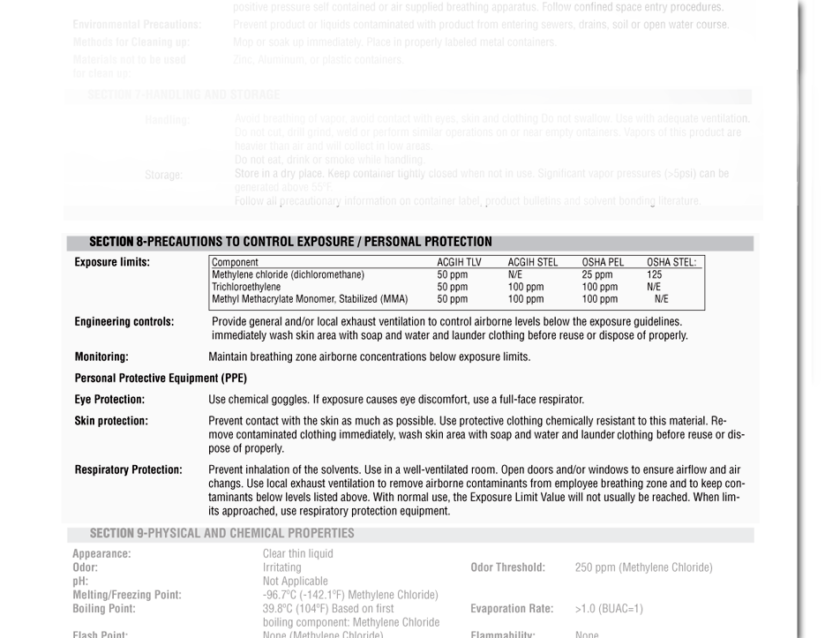
Exposure Controls and PPE
SECTION 8:
© BLR®—Business & Legal Resources 1203
Notes:
Slide Show Notes
Section 8 is a very important section of the SDS because it instructs you on how to protect against harmful exposures.
The section details control parameters, such as occupational exposure limit values. For example, here you’ll find the permissible exposure limit, or PEL, and the threshold limit value, or TLV. You’ll also find biological limit values, if applicable.
In this section, you’ll also read about appropriate engineering controls such as ventilation and enclosed processes required when working with the substance, replacing a toxic substance with a less hazardous one, or limiting the amount of time a worker is exposed to a hazardous substance.
Section 8 also discusses individual protection measures, such as required PPE.
Think about the PPE you are required to wear in the workplace.
Discuss PPE requirements for trainees.

Slide 17
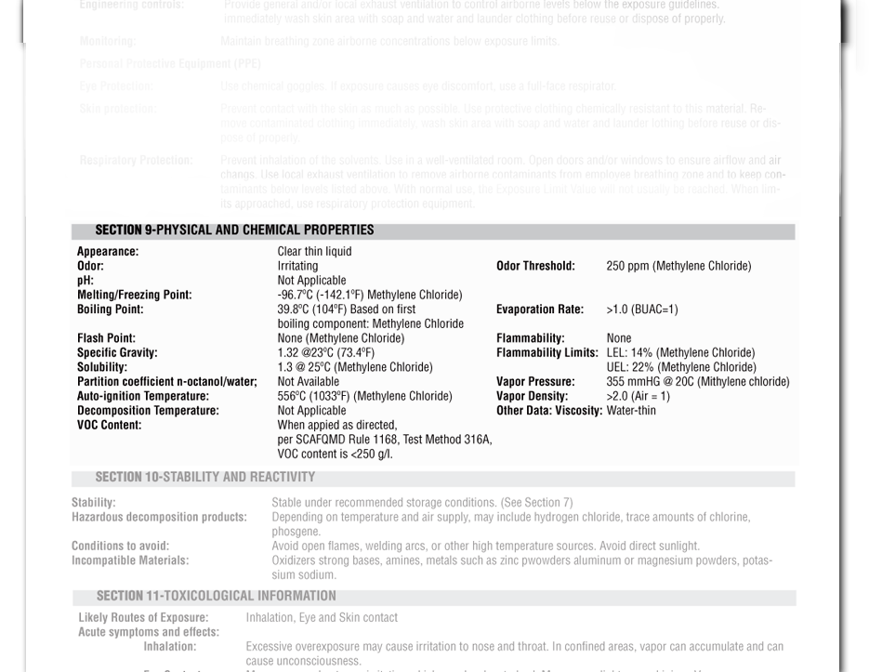
Physical and Chemical
Properties
SECTION 9:
© BLR®—Business & Legal Resources 1203
Notes:
Slide Show Notes
Section 9 includes the information about a substance’s physical and chemical properties, including such vital information as:
- Appearance—that is, the substance’s physical state—solid, liquid, gas, and color;
- Odor and odor threshold;
- pH, which tells you whether the chemical is an acid or base;
- Melting point and freezing point;
- Flash point;
- Evaporation rate;
- Flammability and upper and lower flammability or explosive limits;
- Vapor pressure, vapor density, and relative density;
Solubility;
Partition coefficient: n-octanol/water
Autoignition and decomposition temperature; and
Viscosity.
Are you familiar with all these terms? You should be because the SDS is one of the foundations of Worker Right to Know.
Have trainees define each of the terms identified in Section 9 of the SDS.

Slide 18
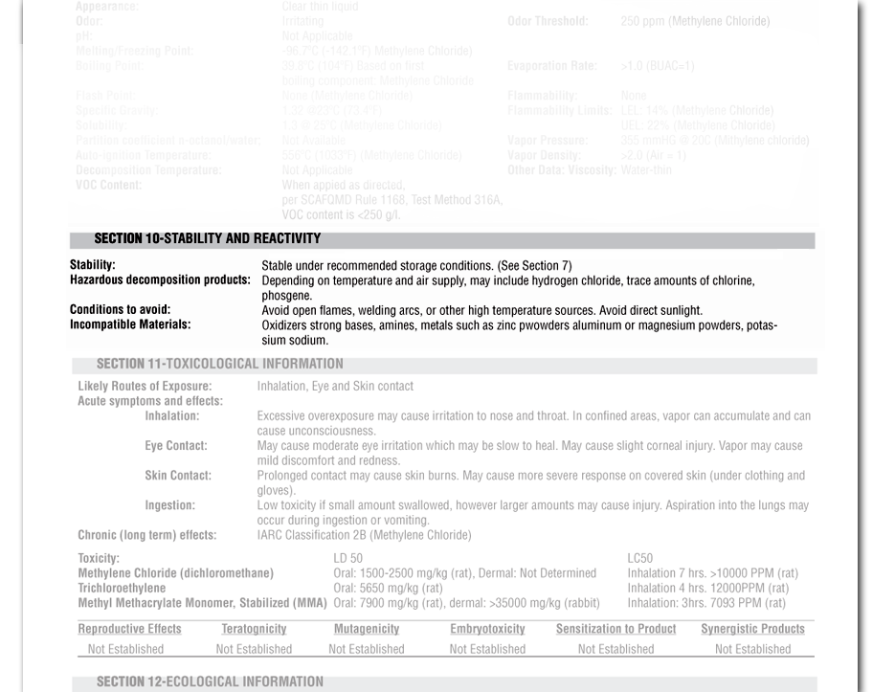
Stability and Reactivity
SECTION 10:
© BLR®—Business & Legal Resources 1203
Notes:
Slide Show Notes
In Section 10 you’ll learn about the substance’s stability and reactivity. These are two very important things to know. You need to know how a substance might become unstable or react with air, water, or other substances and thus become hazardous to you and your co-workers.
In this section, you’ll read about:
- The chemical’s stability or reactivity;
- The possibility of hazardous reactions;
- Conditions to avoid—for example, static discharge, shock, or vibration;
- Incompatible materials that must be kept away from the substance; and
- Hazardous decomposition products.
Think about the importance of this section. What if you didn’t know the conditions under which a substance is stable or unstable? What if you didn’t know what might cause a hazardous reaction? You could be in grave danger.
Give some examples of how knowing about a substance’s stability and reactivity could prevent an accident or exposure.

Slide 19
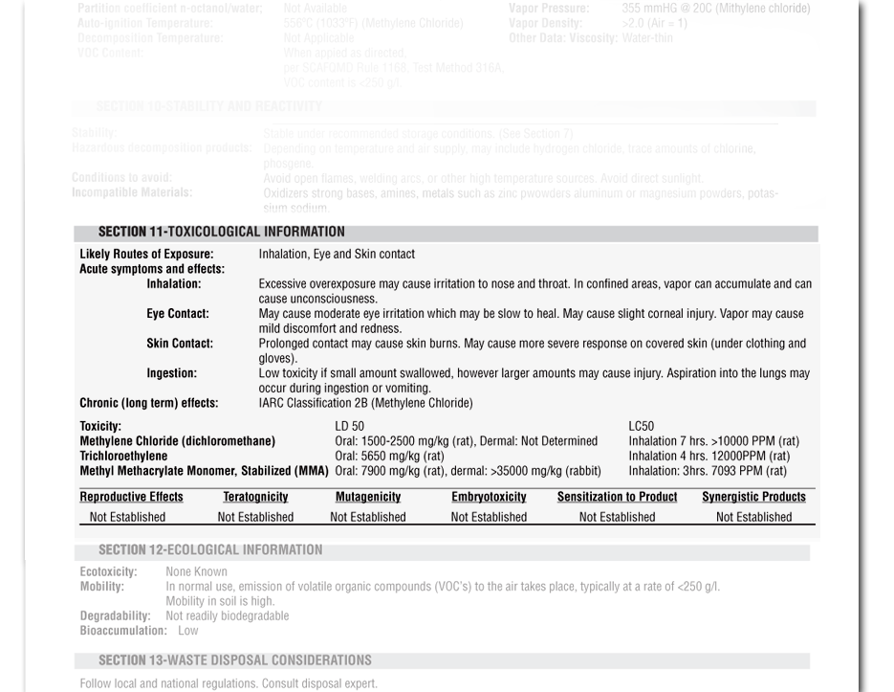
Toxicological Information
SECTION 11:
© BLR®—Business & Legal Resources 1203
Notes:
Slide Show Notes
Section 11 contains a concise but complete and comprehensible description of the various health effects of the substance as well as the available data used to identify those effects, including:
Information on the likely routes of exposure—inhalation, ingestion, skin and eye contact;
Symptoms related to the physical, chemical, and toxicological characteristics;
Immediate and delayed health effects and chronic health effects from short- and long-term exposure;
Numerical measures of toxicity; and
Whether the chemical is listed in the National Toxicology Program (NTP) Report on Carcinogens or International Agency for Research on Cancer (IARC) Monographs, or by OSHA.
If you work with toxic substances, you want to know all there is to know about how to avoid exposures. This section will cover how to protect yourself from exposure to poisons.
Identify the toxic substances used in your workplace and discuss routes of exposure, symptoms of exposure, and health effects of exposure for each substance.

Slide 20
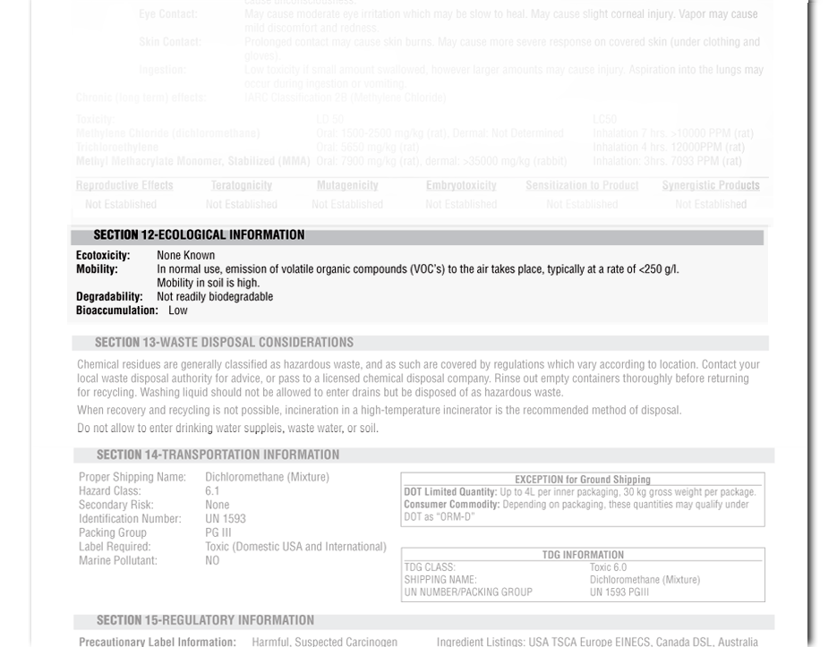
Ecological Information
SECTION 12:
© BLR®—Business & Legal Resources 1203
Notes:
Slide Show Notes
Section 12 contains information about how the substance could affect the environment. The section includes information about:
- Ecotoxicity, which is how the substance poisons aquatic and terrestrial environments;
- Persistence and degradability—in other words, how long the effects of the pollution may last;
- Bioaccumulative potential, which means the likelihood of a hazardous substance being taken into an organism, such as a human or other animal, and accumulating in the body;
- Mobility in soil, which identifies how far and wide the substance is likely to travel in the ground; and
- Other adverse effects such as hazards to the ozone layer.

Slide 21
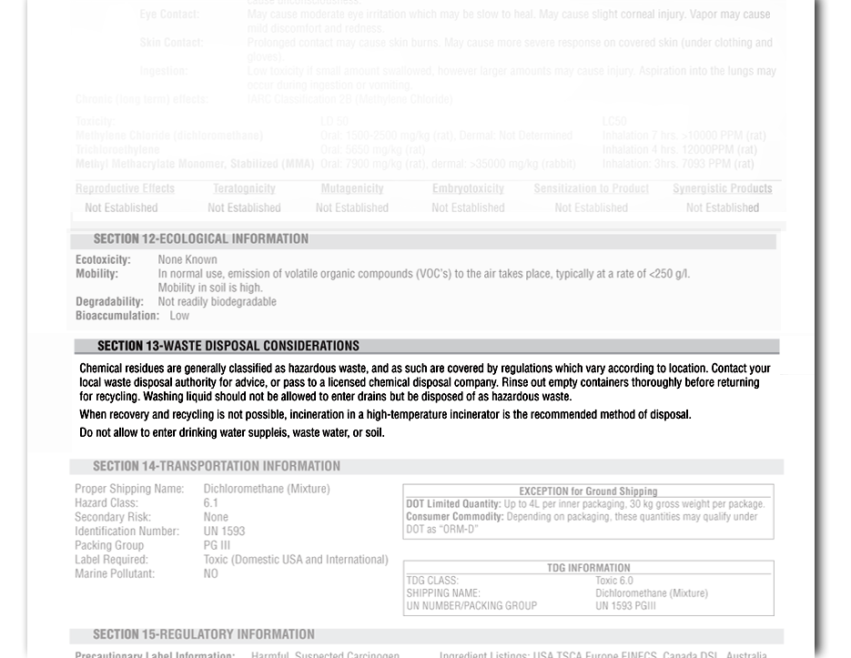
Disposal Considerations
SECTION 13:
© BLR®—Business & Legal Resources 1203
Notes:
Slide Show Notes
Section 13 describes waste residues and provides information about safe handling and methods of disposal of:
- Substances, and
- Contaminated packaging.
Think about the substances you work with and the proper procedures for disposing of these substances and of any contaminated materials.
Review required procedures for disposal of substances in your workplace.

Slide 22
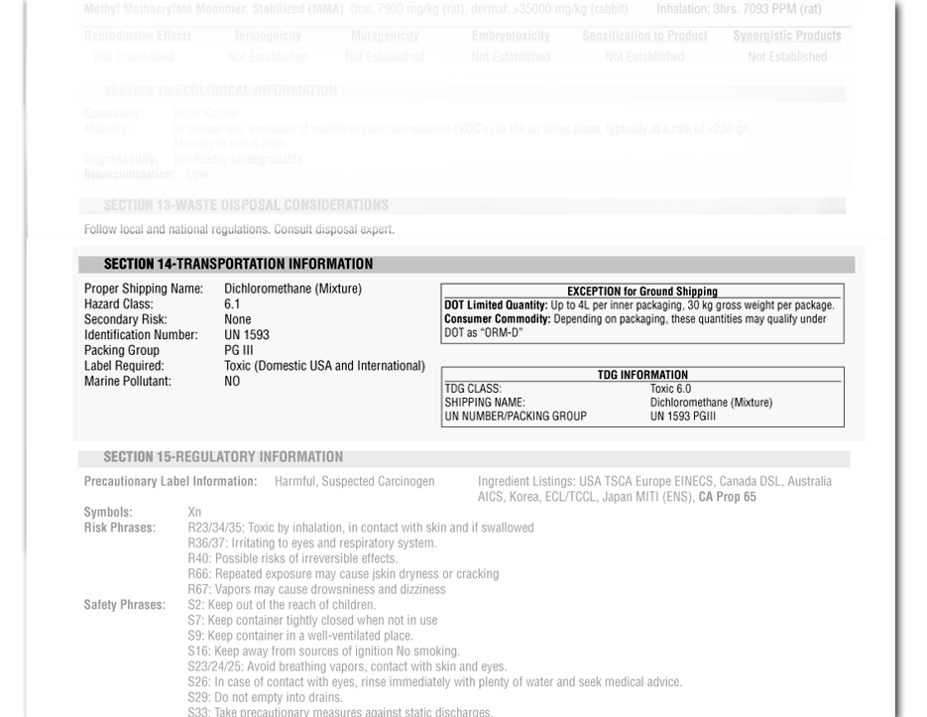
Transportation Information
SECTION 14:
© BLR®—Business & Legal Resources 1203
Notes:
Slide Show Notes
Section 14 explains requirements for the safe transportation of the chemical. This section tells you:
The United Nations, or UN, number for the chemical, and the UN shipping name;
The transport hazard class or classes;
The packing group, if applicable;
Whether the substance is a marine pollutant;
Transport in bulk; and
Special precautions a user needs to know or to comply with in connection with transport of the chemical either inside or outside of your workplace.

Slide 23
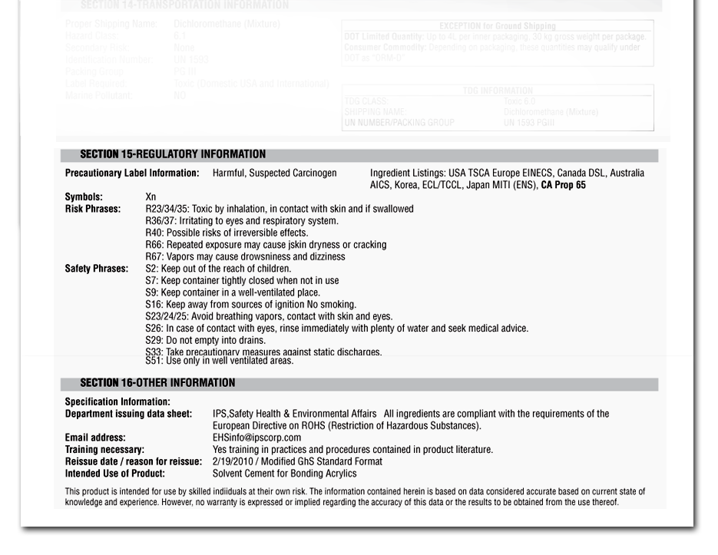
Regulatory and Other
SECTION 15 & 16:
© BLR®—Business & Legal Resources 1203
Notes:
Slide Show Notes
Section 15 contains information about the safety, health,
and environmental regulations for specific substances.
Section 16 contains other relevant information, including date of information on preparation and revision of the SDS.

Slide 24
Exercise
Match the SDS section with the topic it covers
Section 5
Section 7
Section 8
Section 9
Section 10
Section 11
Section 13
Exposure controls and PPE
Stability and reactivity
Chemical properties
Fire fighting
Toxicology
Handling / Storage
Disposal
Notes:
Slide Show Notes
Now it’s time for an exercise to see how much you remember about the information about the different sections of the SDS we presented in the previous slides. On the screen in the column on the left you see various sections of the SDS listed. In the column on the right are a list of topics covered by those sections. Your job is to match the sections with the information they contain. [PAUSE]
Did you make the following matches?
Section 5 and fire fighting;
Section 7 and handling and storage;
Section 8 and exposure controls and PPE;
Section 9 and chemical properties;
Section 10 and stability and reactivity;
Section 11 and toxicology; and
Section 13 and disposal.

Slide 25

Key Points to Remember
It is essential to have complete and accurate information about the substances you use
The SDS helps prevent accidents and exposures
Always consult the SDS for the substances
you use on the job.
Notes:
Slide Show Notes
Here are the main points to remember from this training session
on understanding the safety data sheet (SDS):
It’s essential to your safety and health to have and know how to find complete and accurate information about the substances you work with.
The SDS provides the information you need to prevent accidents and exposures that can be hazardous or toxic.
Be sure to always consult the SDS for the substances you use on
the job.
This concludes the Understanding the Safety Data Sheet (SDS) training program.
Give trainees the quiz.

