Slide 1
Lesson Plan
Objectives
  1, To under stand what an MCI is.
  2, Who can declare there is an MCI.
  3, What is START Triage.
  4, How to use START triage.
  5, Know were your MCI triage kits are stored.
  6, Know were you MCI equipment is stored.
  7, Know what is in you MCI tubs.

Slide 2
Lesson Plan
Environment
  Class room by use of a power point presentation
Student Background
  All Students will be Township firefighter
Assessment
  All students will be able to Know what an MCI is
  Able to find Triage kits and know how to use them
  Know were there MCI equipment is keeped

Slide 3
Township Fire
Mass Casualty
Incident Plan

Slide 4
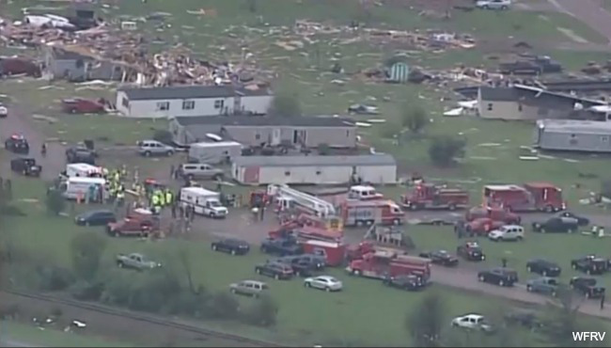
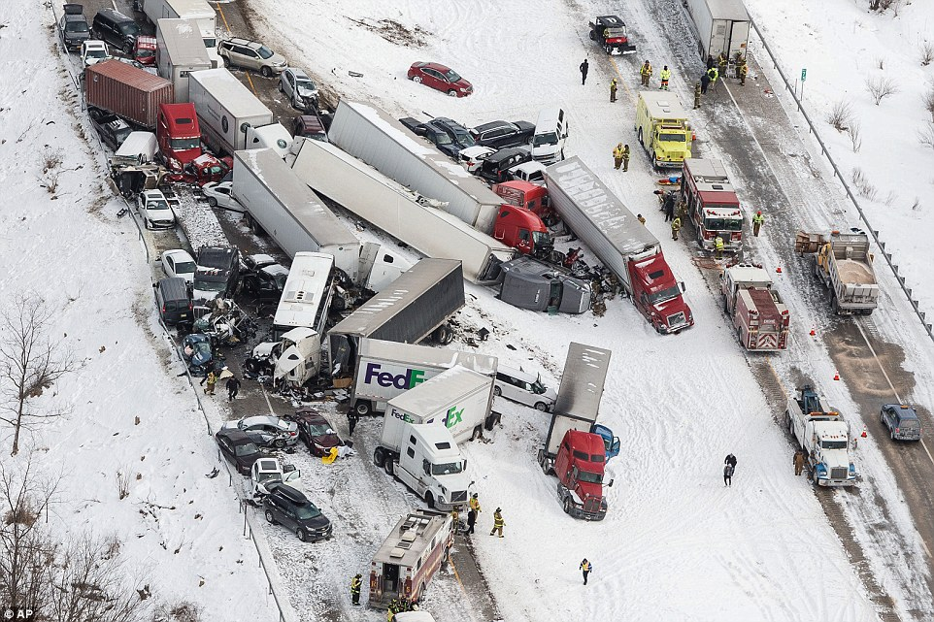
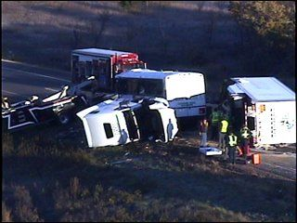
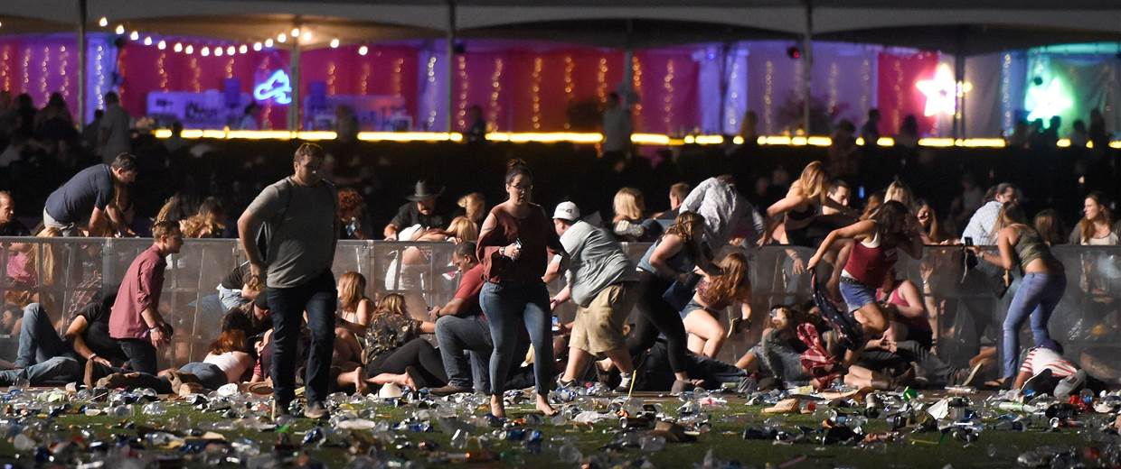
Are You Ready

Slide 5
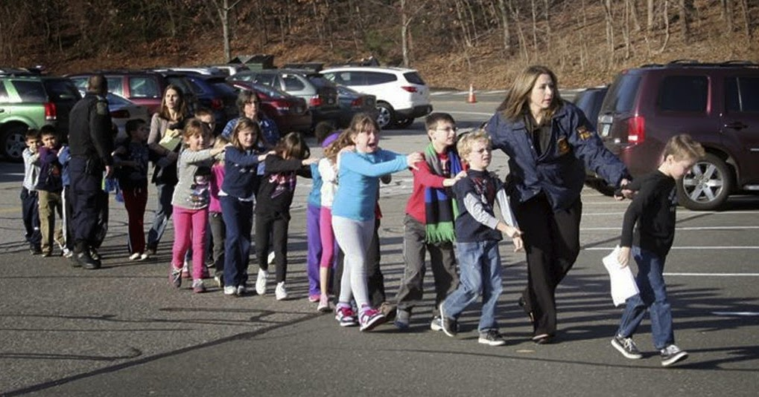
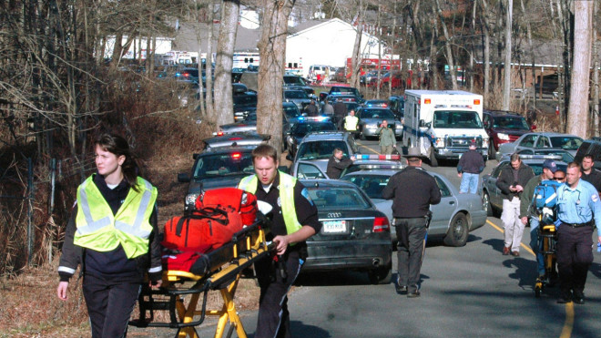
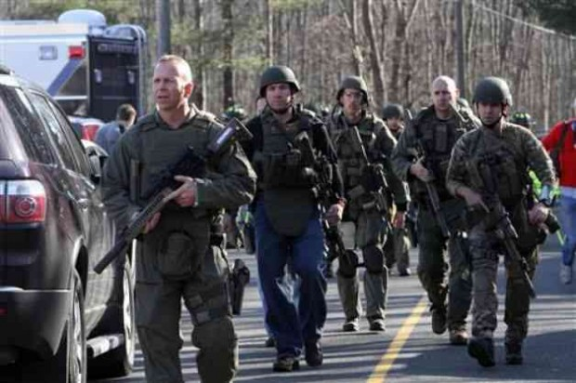
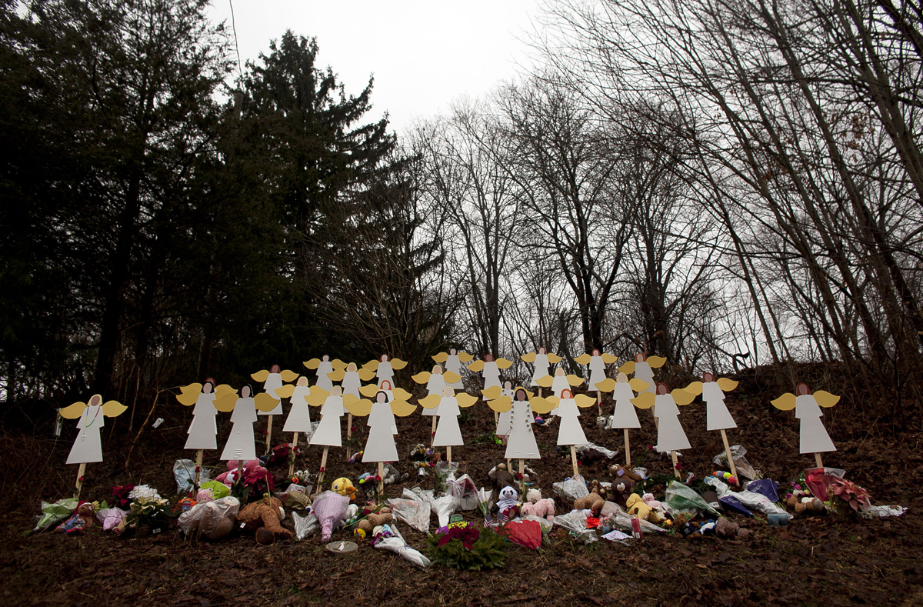
Sandy Hook 12/14/2012

Slide 6
For its not a matter of if it will happen
It is only a matter of when it will happen
And what it will be

Slide 7
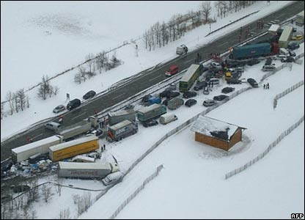
Multiple Vehicle Accidents

Slide 8
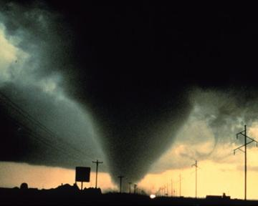
Tornado

Slide 9
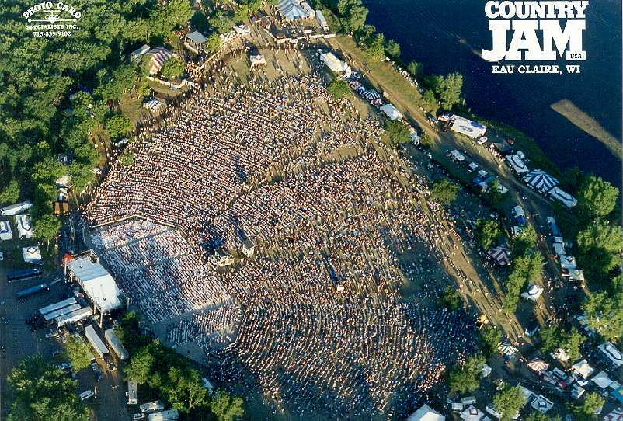

Slide 10
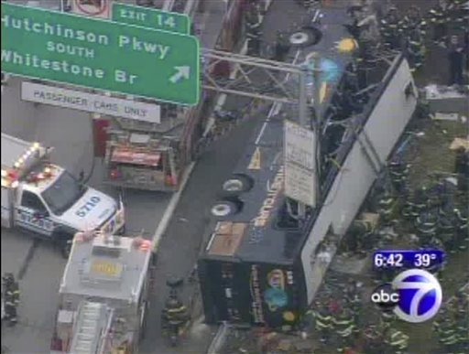
When and how to use START Triage

Slide 11
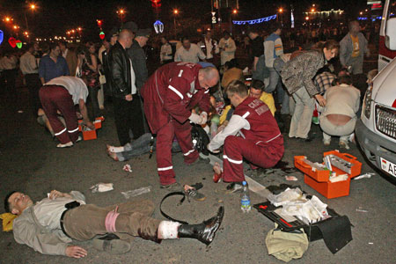
Any time the Number of victims over stretches your resources

Slide 12
START TRIAGE Stands For
S
T
A
R
T
Simple
Triage
And
Rapid
Treatment

Slide 13
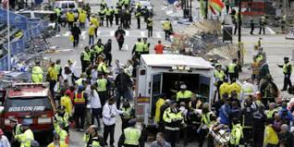
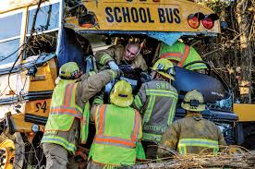
How do we do START Triage Step by step

Slide 14
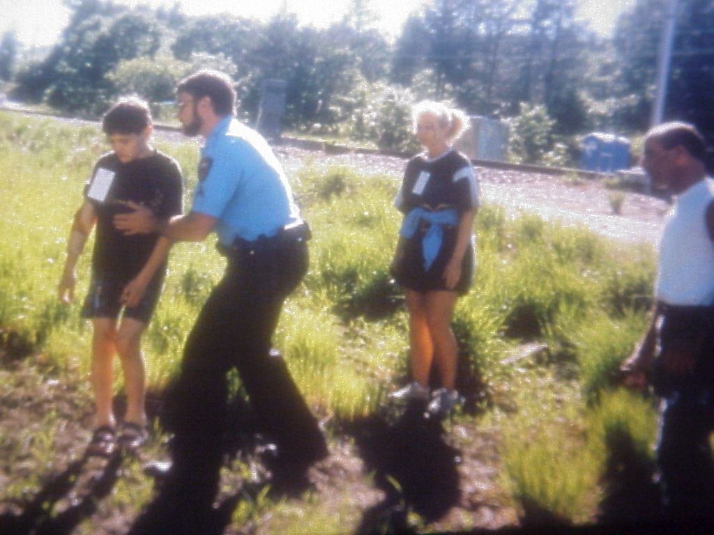
Step One
First remove all the walking wounded.
Triage them all
GREEN ( MINOR ) walking wounded.
Direct walking wounded to predetermined treatment area.
Place someone in charge.

Slide 15
Step Two R-P-M TEST
Respiration
Perfusion
Mental Statues
R
P
M

Slide 16
R P M Test
Respiration's 30 or more
Perfusion No radial pulse, Slow Cap refill
Mental Statues LOC Can not respond to you

Slide 17
RPM Test
If they fail the RPM test.
Red Immediate
If they pass the RPM test.
Yellow Delayed

Slide 18
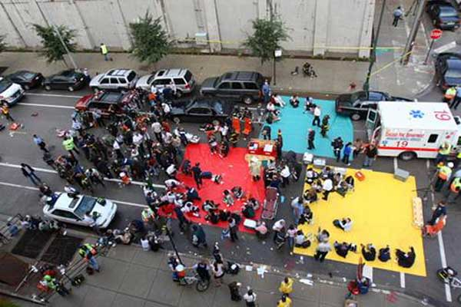
Rapid Treatment
If patient has major bleeding.
You can stop major bleeding only.
People who need CPR are triage Black
Do not do start CPR with the limited resources.

Slide 19
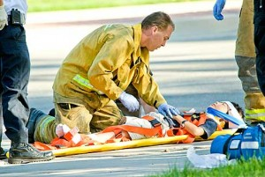
Jump START Pediatric Patients
Not breathing open airway
Apneic with a pulse give 5 rescue breaths.
If they start breathing (Red Immediate)
Do not start breathing (Black Deceased)
Respiration rate <15 or >45 (Red Immediate )

Slide 20
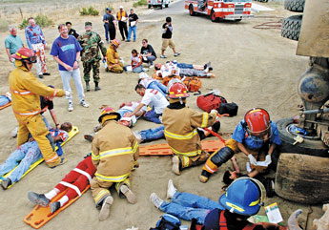
Equipment We Need On a MCI Call

Slide 21
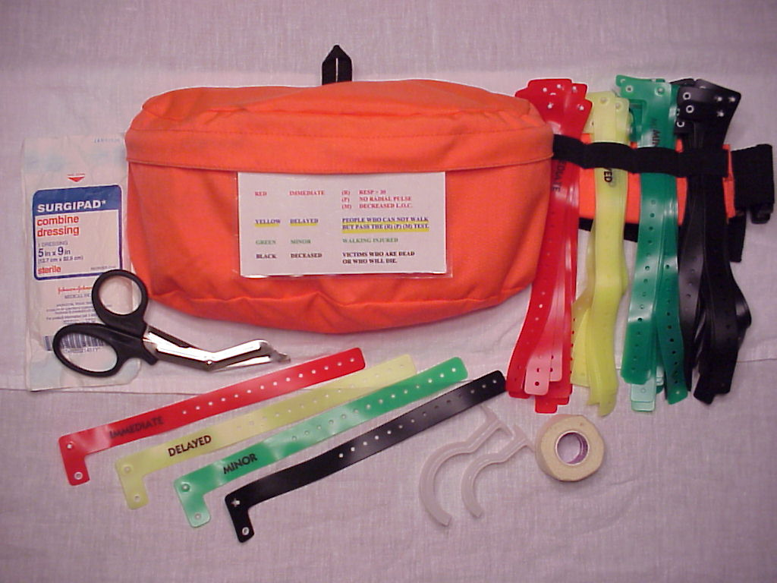
Township Fire & Eau Claire County Triage Kits
Triage wrist bands
20 Red
20 Yellow
20 Green
20 Black
10 Airways Large
10 Airways Small
10 5x9 Dressings
1 1” Adhesive tape
1 Utility Scissors
1 Start Triage Card

Slide 22
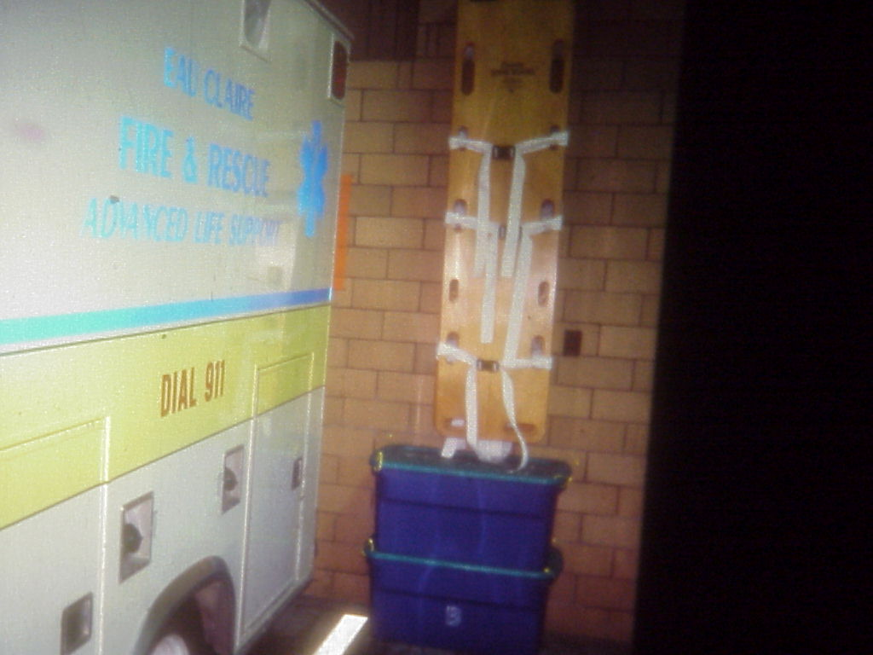
MCI Station Supplies
Eau Claire County has MCI supplies located at every
Fire Stations (15)
Mayo-One
Hospitals (2)
Airport
Two MCI supply tubs and 5 back boards

Slide 23
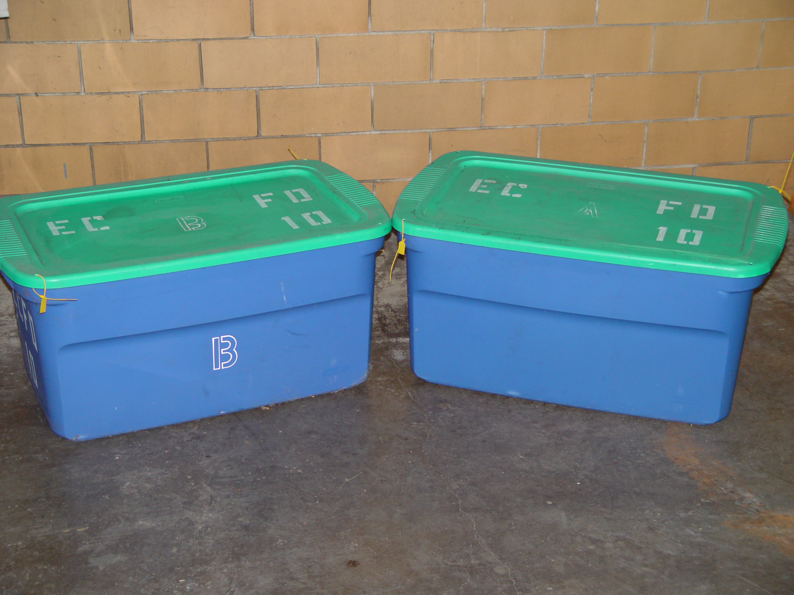
MCI Tubs
Two Tubs (A & B)
Tub (B) Blankets
5 wool blankets
5 disposable blankets
5 aluminum blankets
Tub (A)
All the other EMS equipment.

Slide 24
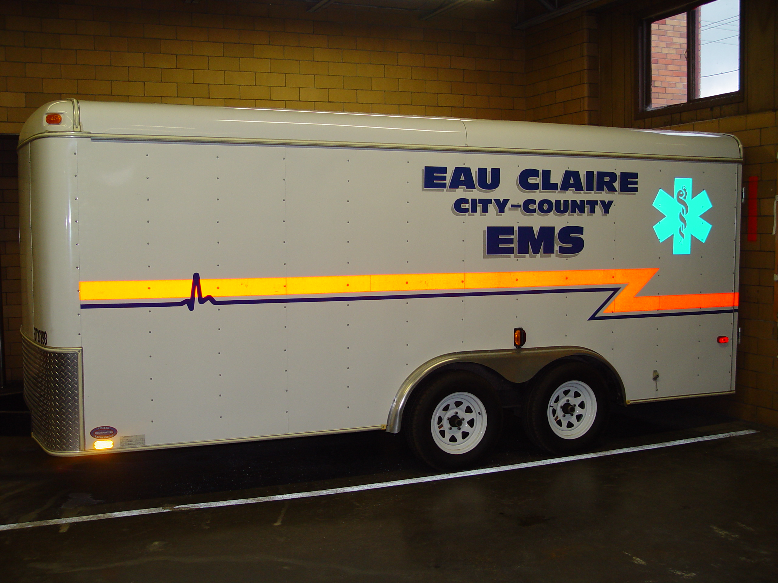
MCI Trailer Equipment

Slide 25
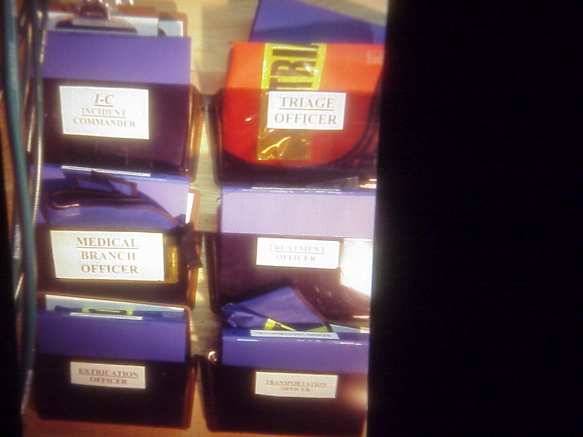
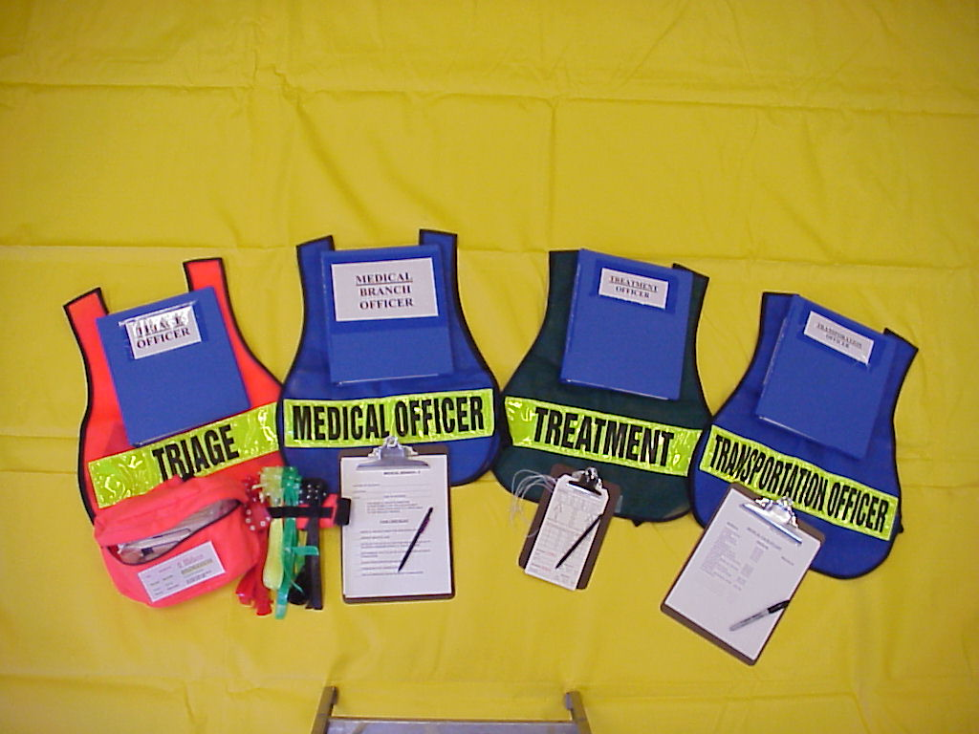
Job Assignment Vests & Supplies

Slide 26
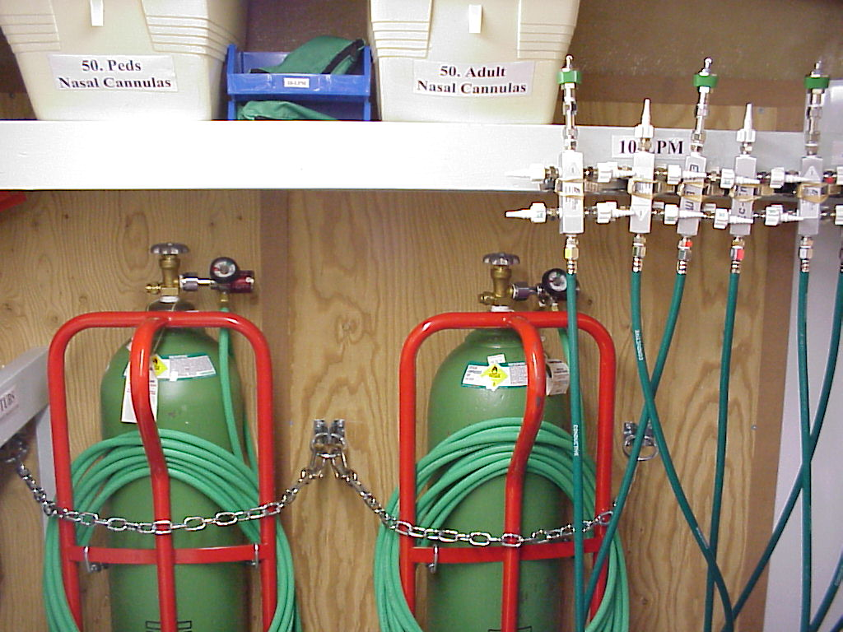
Oxygen Equipment
Able to deliver oxygen to 32 patients at one time
Portable and has 20 foot hose on each tank
Easy to use
Able to regulate 4Lpm or 10Lpm
Will last for 43 minutes with 32 patients at 10Lpm

Slide 27
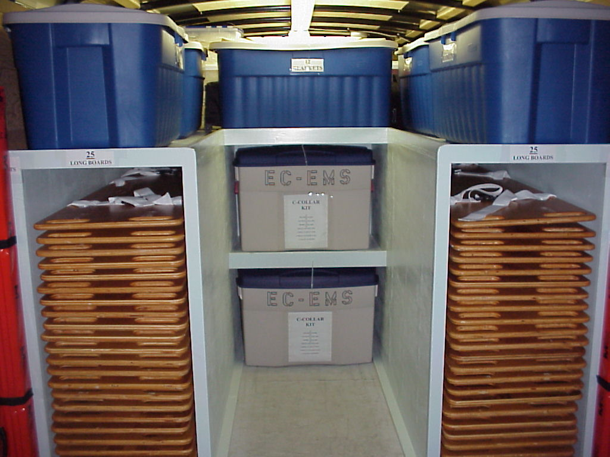
Back MCI Trailer
50 backboards are in the MCI trailer
150 C-collars 50 (L) 50 (M) 50 (S)
50 head beds
100 blankets
10 long wood splints
6 portable chairs

Slide 28
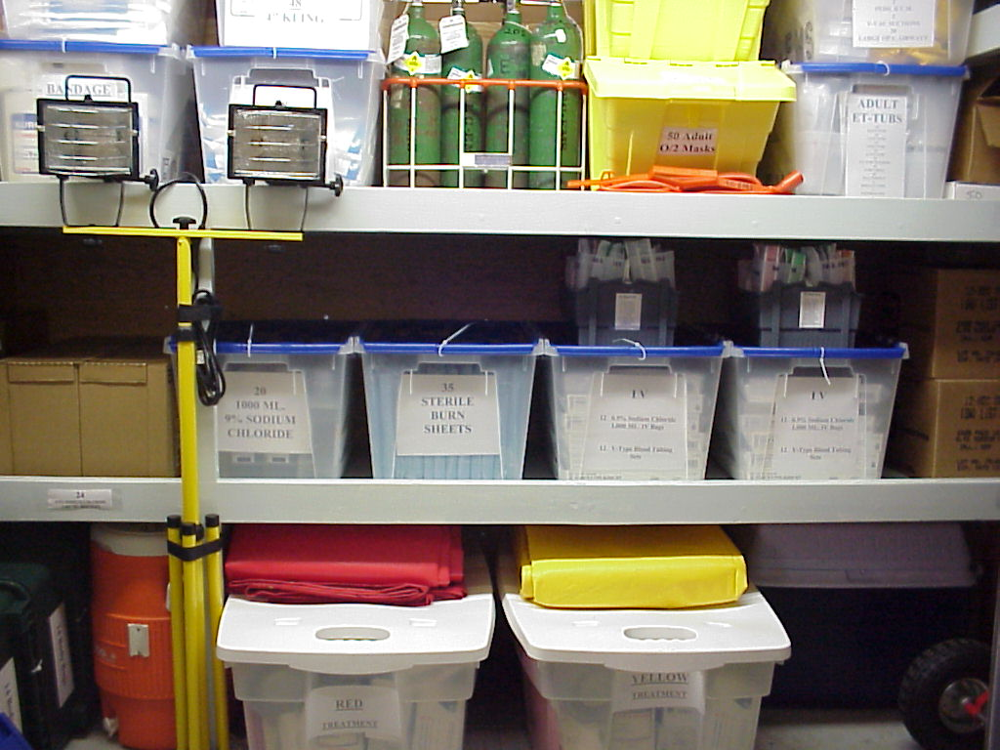
Medical Supplies
Red Yellow Green treatment area kits
Burn kit
Airway kit
IV kit
Splinting kit
Trauma kit
Portable lighting
Water and ice cooler
Biohazard

Slide 29
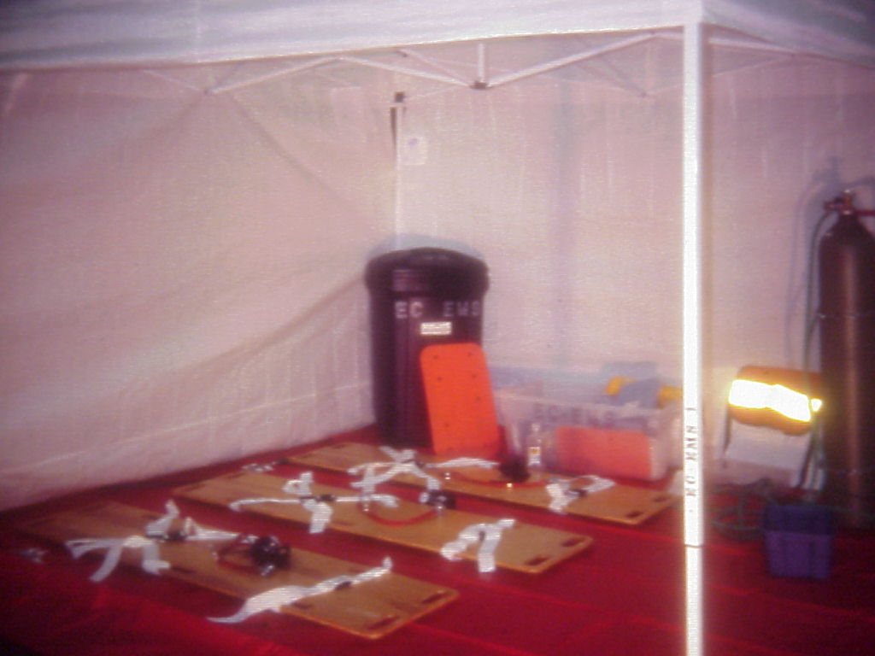
Portable E-Z Up Shelters

Slide 30
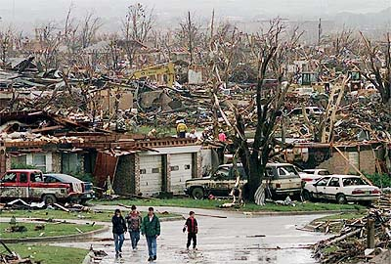
How Do handle an MCI

Slide 31
With Command and Control

Slide 32
Only Sector Officers should Use Radio Communications

Slide 33
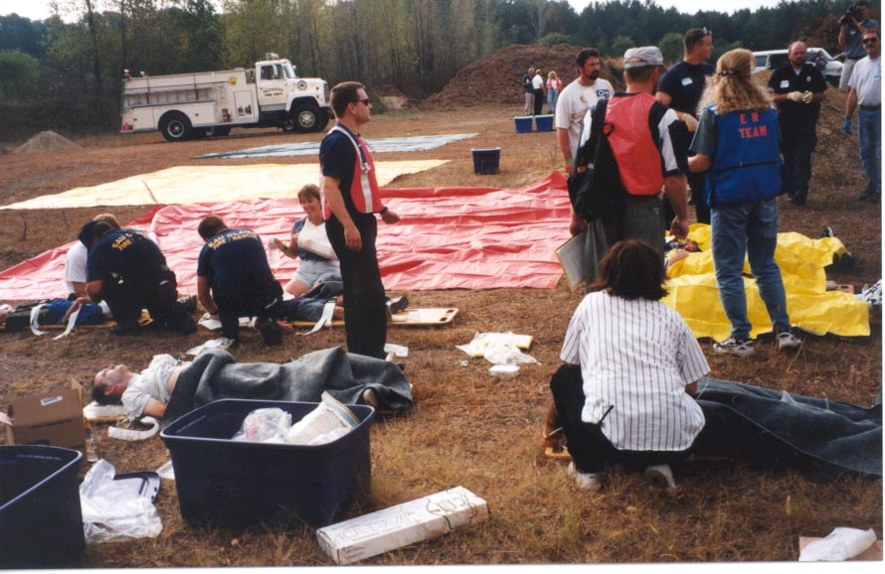
Control
If you don’t take control of the incident
The incident will take control of you

Slide 34
MCI Test
1, What is the definition of a MCI
  Car Accident with one patient
  A tornado
  When the patients out number the resources
  When you just don’t know what to do
2, Who can declare an MCI
A. The First Responder
B. The Incident Commander
C. A Firefighter EMT
D. All the above
3, What is the color of the most immediate patient in START triage
A, Red B, Yellow
C, Green D, Black

Slide 35
4, A patient who is unable to walk alert with pulse of 80 and respirations of 20 would be?
A, Red B, Yellow
C, Green D, Black
5, A 13 year old boy who is not breathing and unresponsive, you open his airway and he starts breathing is triaged?
A, Red B, Yellow
C, Green D, Black
6, A 14 year old girl alert pulse of 100 respirations of 18 but can not move is ?
A, Red B, Yellow
C, Green D, Black

Slide 36
7, A 20 year old female who is unresponsive with respirations of 24 and a pulse of 80 would be triaged ?
A, Red B, Yellow
C, Green D, Black
8, A 12 year old boy who is unresponsive not breathing with out a pulse is triaged ?
A, Red B, Yellow
C, Green D, Black
9, A 30 year old male who is walking around with a open fracture of his (L) arm with a pulse of 80 respirations of 20 and alert.
A, Red B, Yellow
C, Green D, Black

Slide 37
MCI Test Answers
1, What is the definition of a MCI
  Car Accident with one patient
  A tornado
  When the patients out number the resources
  When you just don’t know what to do
2, Who can declare an MCI
A. The First Responder
B. The Incident Commander
C. A Firefighter EMT
D. All the above
3, What is the color of the most immediate patient in START triage
A, Red B, Yellow
C, Green D, Black

Slide 38
4, A patient who is unable to walk alert with pulse of 80 and respirations of 20 would be?
A, Red B, Yellow
C, Green D, Black
5, A 13 year old boy who is not breathing and unresponsive, you open his airway and he starts breathing is triaged?
A, Red B, Yellow
C, Green D, Black
6, A 14 year old girl alert pulse of 100 respirations of 18 but can not move is ?
A, Red B, Yellow
C, Green D, Black

Slide 39
7, A 20 year old female who is unresponsive with respirations of 24 and a pulse of 80 would be triaged ?
A, Red B, Yellow
C, Green D, Black
8, A 12 year old boy who is unresponsive not breathing with out a pulse is triaged ?
A, Red B, Yellow
C, Green D, Black
9, A 30 year old male who is walking around with a open fracture of his (L) arm with a pulse of 80 respirations of 20 and alert.
A, Red B, Yellow
C, Green D, Black

