Slide 1


Scene Size Up

Slide 2
The basics for ANY call
Identify Yourself
What do you see?
Conditions
Action – what are you going to do?
Establish Command

Slide 3
Other Factors to be considered:
Time of Day
  Number of Personnel Available?
  Traffic/Road Conditions?
Weather Conditions
  Extreme Heat or Cold
  Windy
  Snow or Rain
Water Supply
  Fill Sites
  Do you need more?

Slide 4
Structure Fires

Slide 5
Structure Fire size up:
Identify yourself
What do you see?
  Type of construction
  Number of stories/involved
  Residential or Commercial?
  Where is the fire located in the structure?
  Need for Rescue?

Slide 6
Structure Fire size up: Continued
Conditions
  Fire/Smoke conditions
  Exposures?
  Egress problems?
What are you going to do?
Establish Command

Slide 7
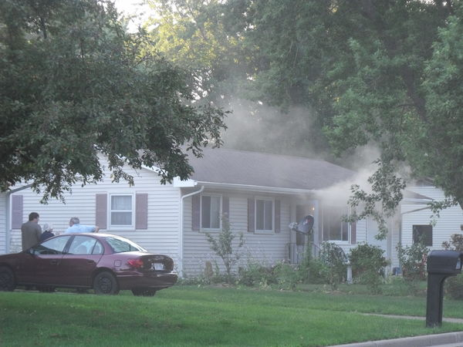
“Engine 7 is on the scene at 1234 Smith Street. We have a one-story residential structure with light smoke showing from side A. Engine 7 will be laying a supply line and going in with a handline for search and rescue. This is an offensive fire attack. Show Engine 7 as Smith Street command.”

Slide 8
Wildland Fires

Slide 9
Wildland Fire size up:
Identify yourself
What do you see?
  Approximate Size
  What's burning
  Exposures
Conditions
  Flame Height and Direction of Travel
  Egress Problems?
What are you going to do?
Establish Command

Slide 10
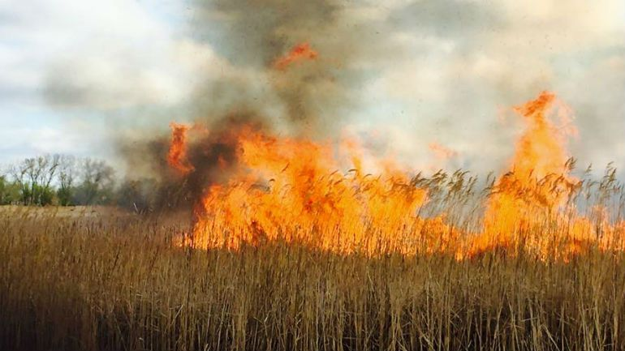
Officers, give your scene size up

Slide 11
Car Fire/Accidents

Slide 12
Car crashes size up:
Identify yourself
What do you see?
  Number and types of Vehicles involved
  Number of Injured
Conditions
  Extrication
  Fire
  Fluids Leaking
  Lane Blockage
Establish Command

Slide 13
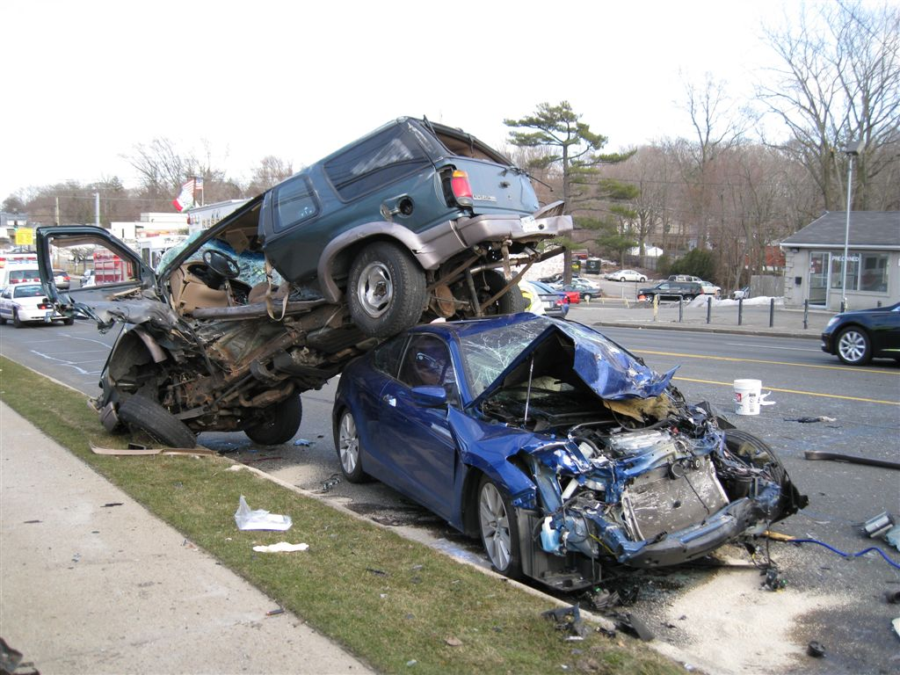
Officers, give your scene size up

Slide 14
Practice Time!!!

Slide 15
Directions
With a radio, send 2-3 people out into a different part of the station where they can't see the PowerPoint
Have one person give a scene size up over the radio to those that left (using a Town channel or Fireground channel).
People hearing the size up, roughly draw out your interpretation of the size up given
Come back in and show the pics and discuss how good it was or where it could improve
Everyone should take a turn giving a size up

Slide 16
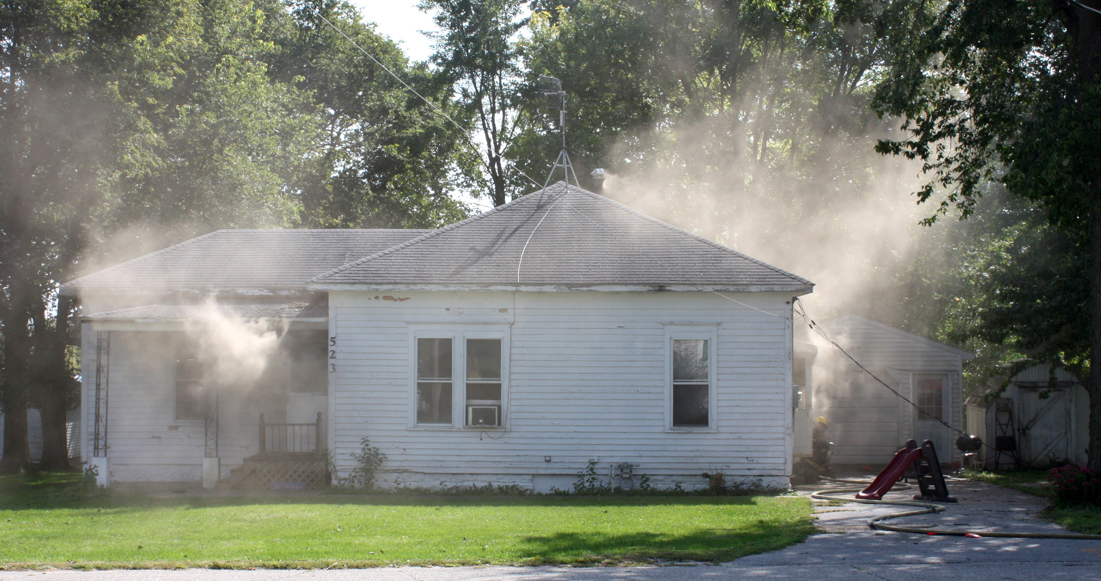

Slide 17
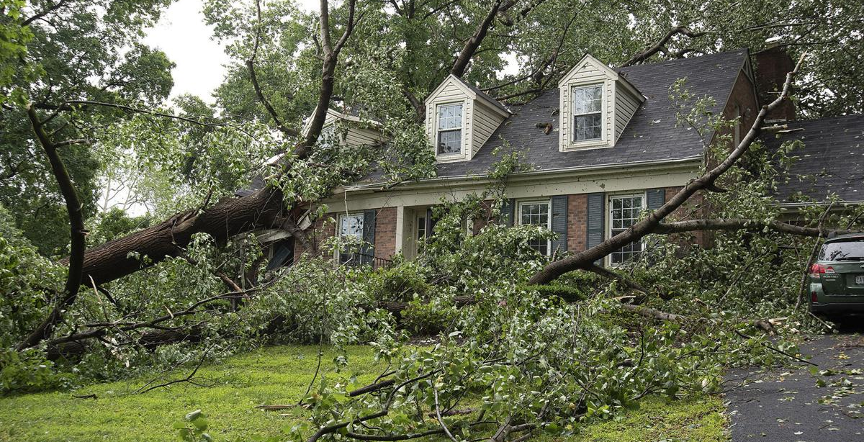

Slide 18
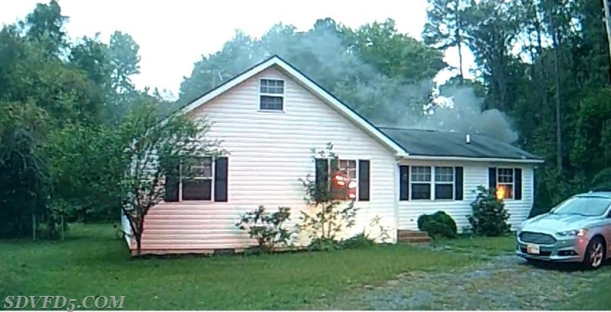

Slide 19
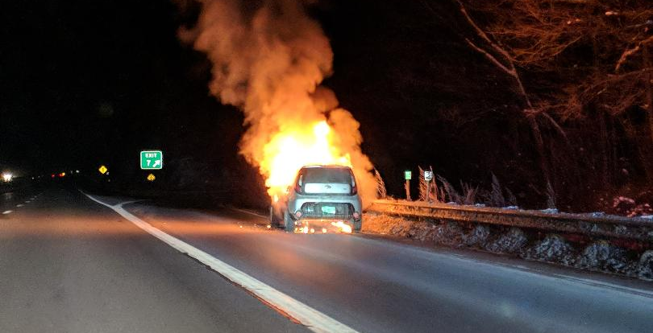

Slide 20
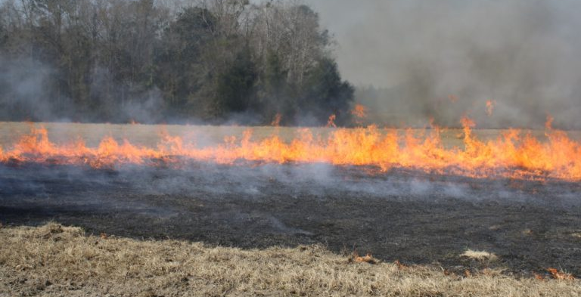

Slide 21
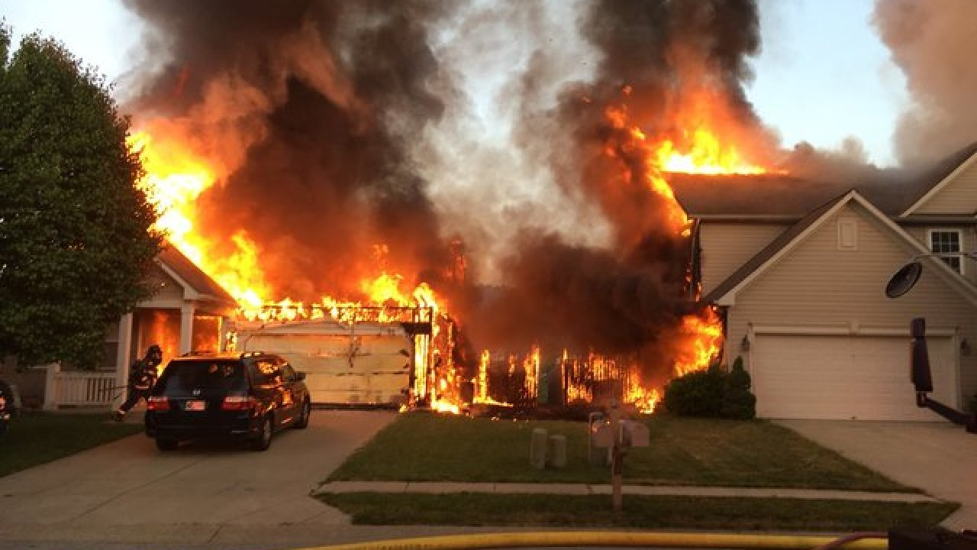

Slide 22
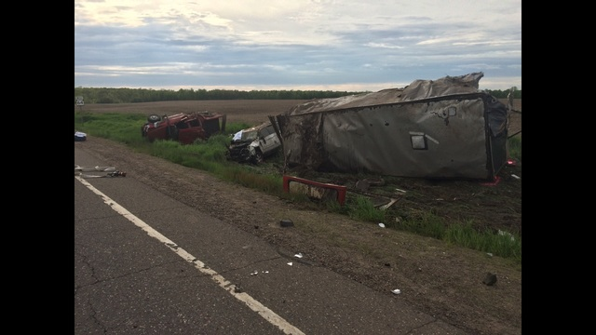

Slide 23
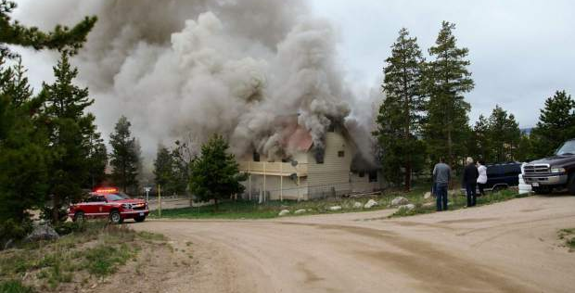

Slide 24
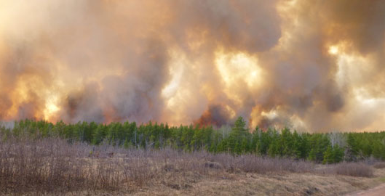

Slide 25
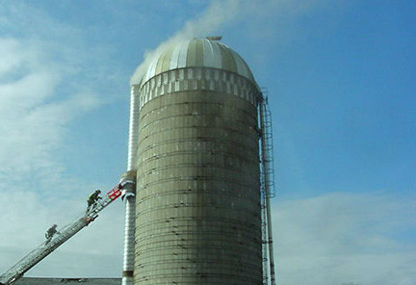

Slide 26
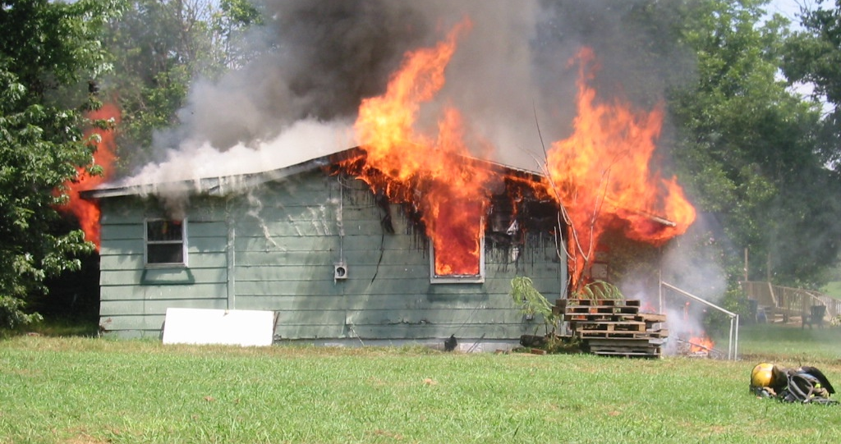

Slide 27
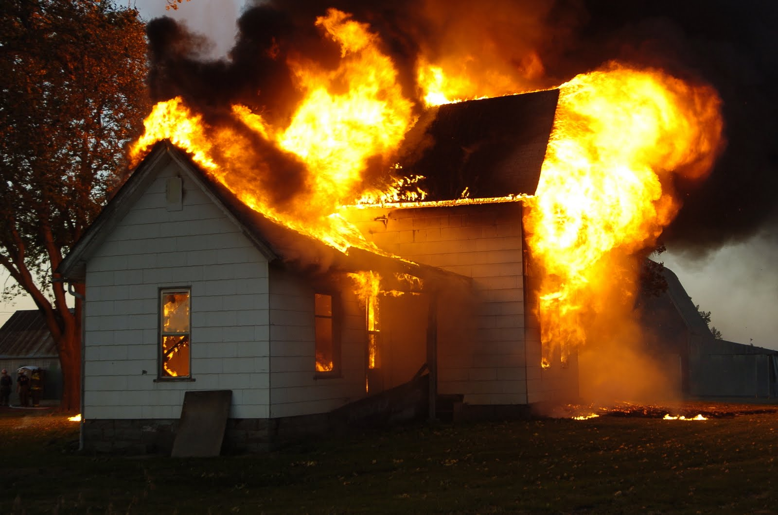

Slide 28
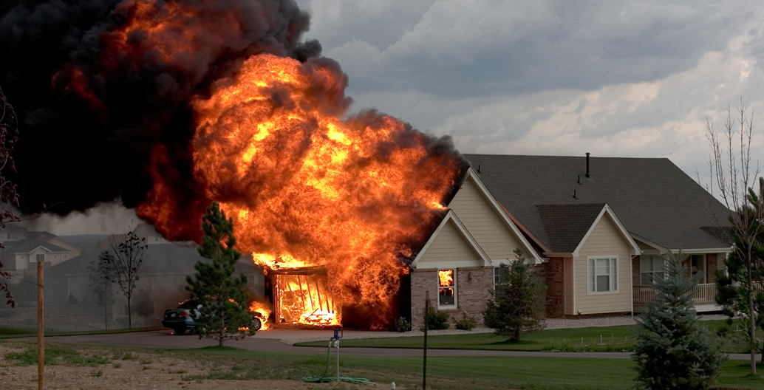

Slide 29
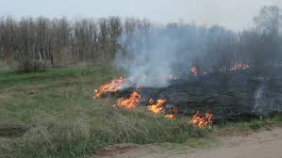

Slide 30
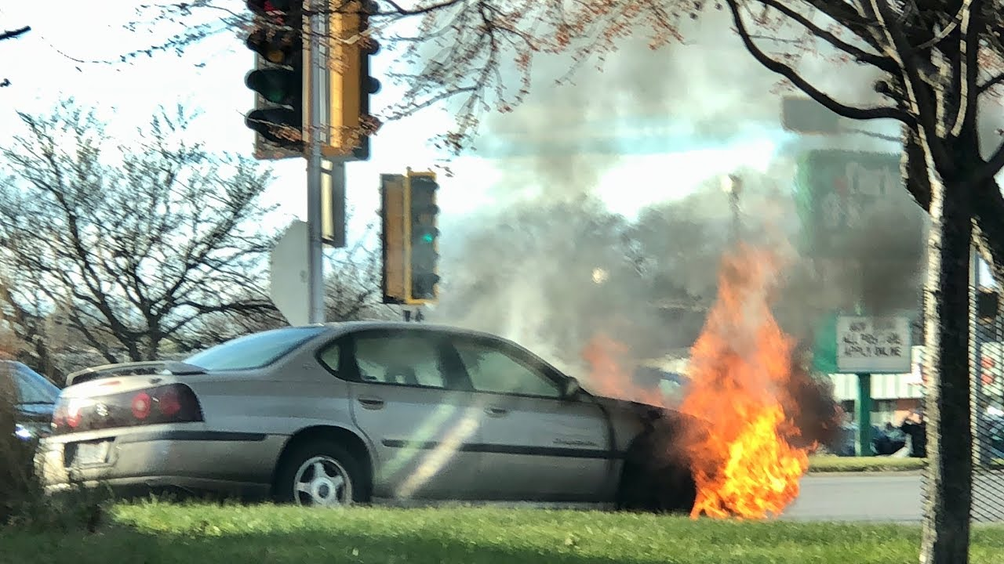

Slide 31
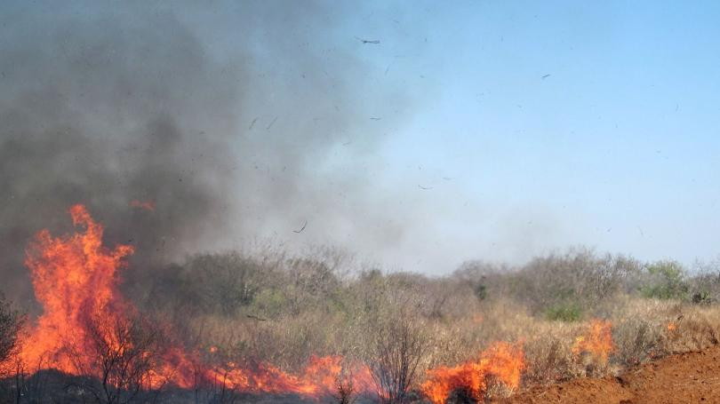

Slide 32
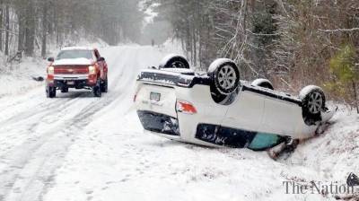

Slide 33
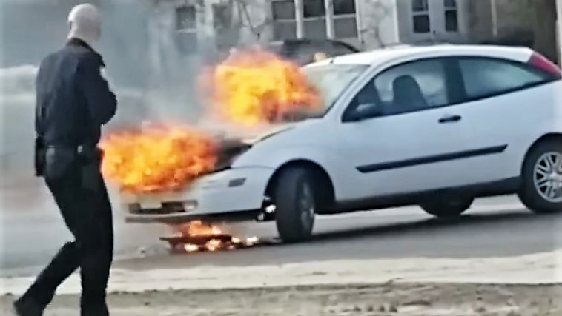

Slide 34
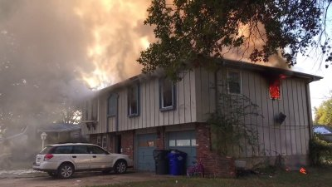

Slide 35
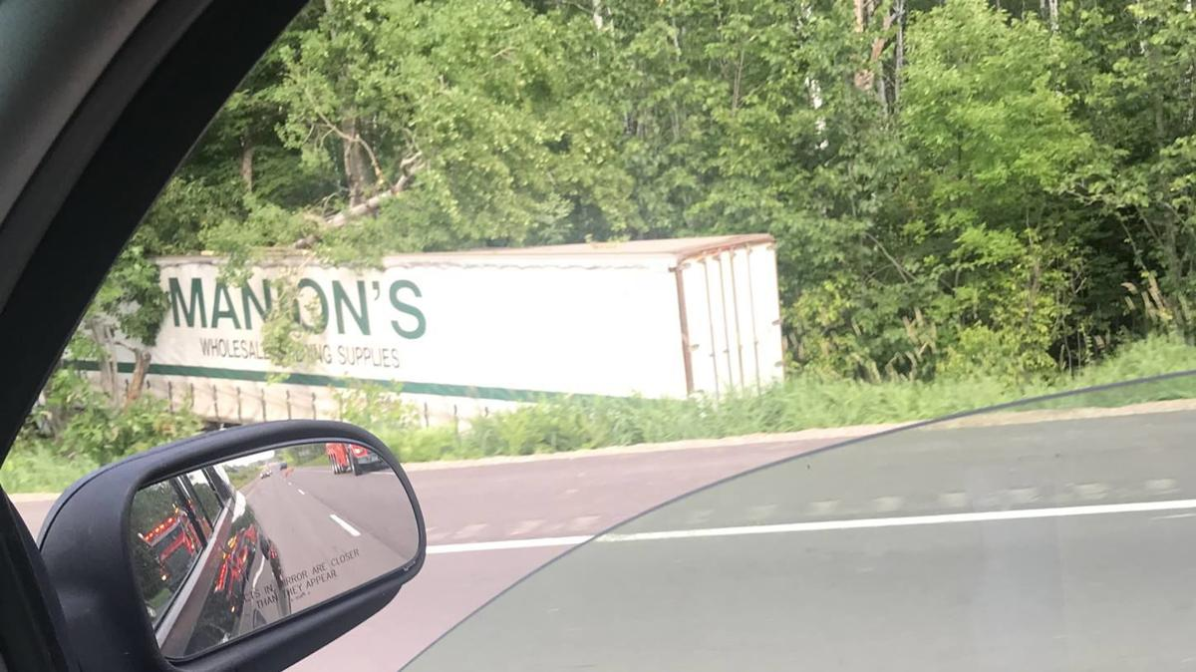

Slide 36
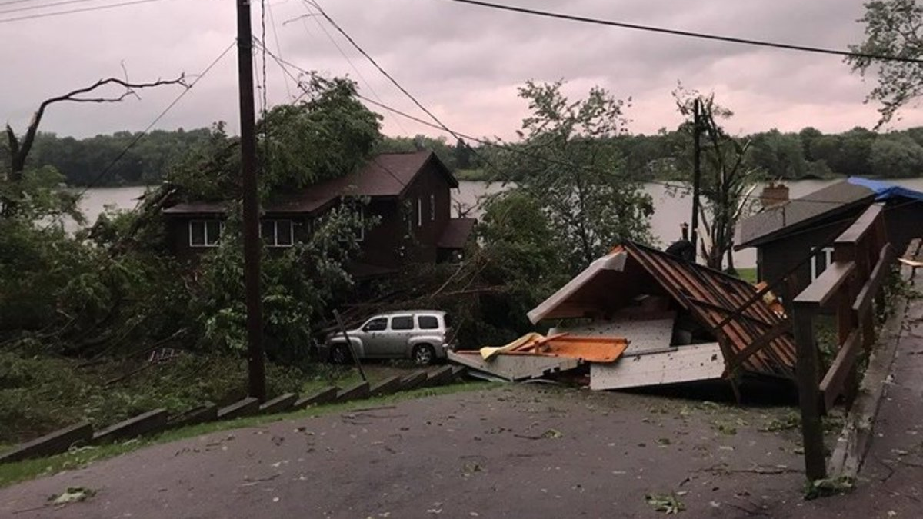

Slide 37
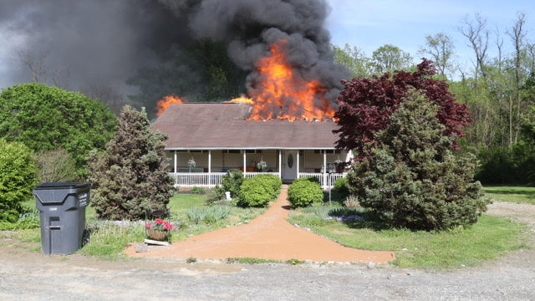

Slide 38
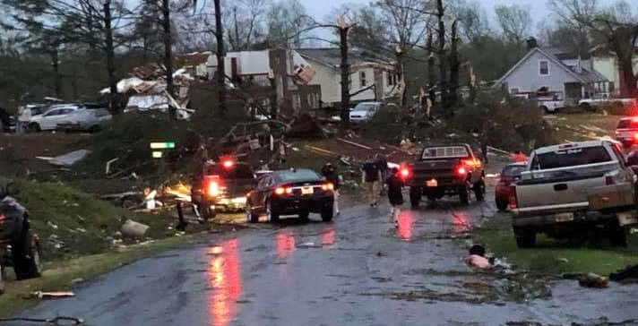

Slide 39
The End!

