Slide 1

TOWNSHIP FIRE DEPARTMENT
EQUIPEMENT FAMILIARIZATION

Slide 2
Objective
Identify tools and equipment commonly used on the fire ground.
Describe how the tool or equipment can be used and how to use it safely.
Locate the tool or equipment. Which apparatus or other location can it be found?
Describe proper maintenance and/or repair procedures.

Slide 3
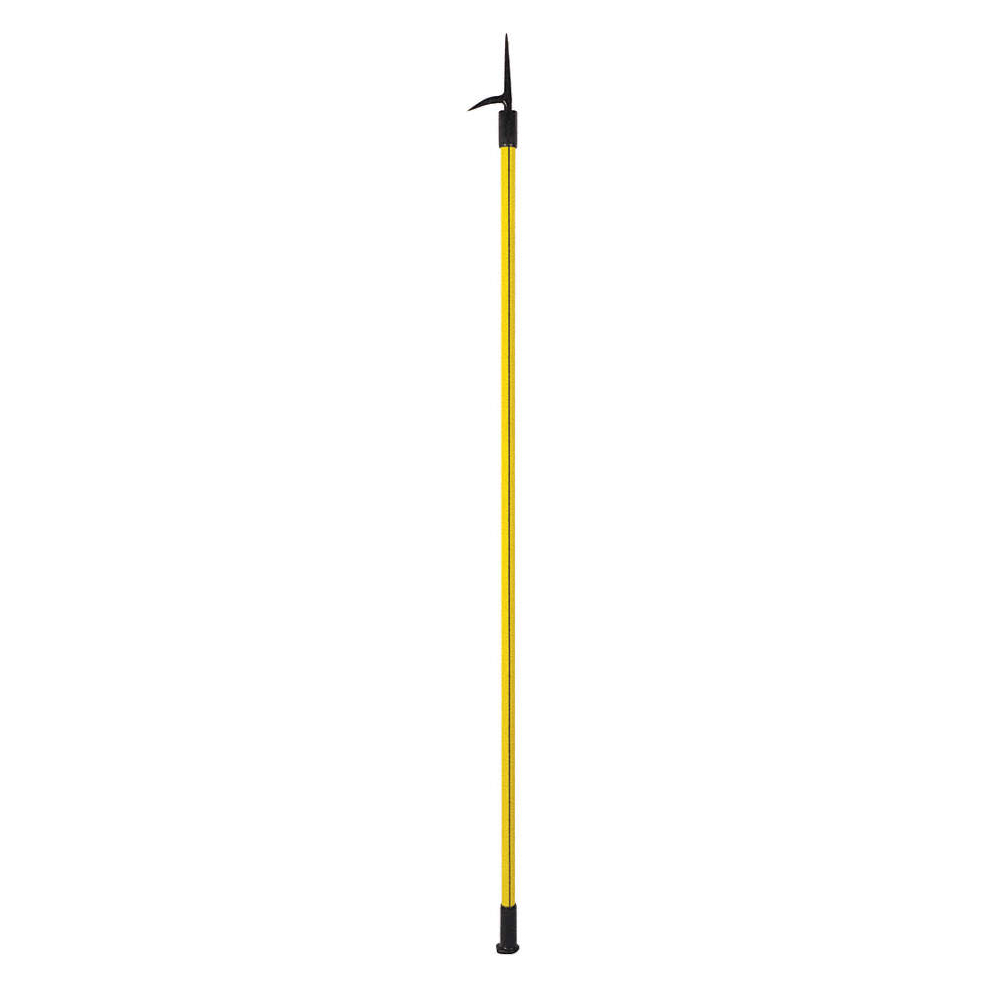
What is the name of this?
Where can it be located?
How do you use it and in what scenarios can it be used?
Any safety precautions?
Maintenance?

Slide 4
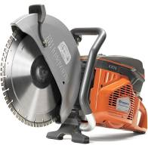
What is the name of this?
Where can it be located?
How do you use it and in what scenarios can it be used?
Any safety precautions?
Maintenance?

Slide 5
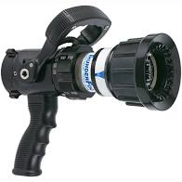
What is the name of this?
Where can it be located?
How do you use it and in what scenarios can it be used?
Any safety precautions?
Maintenance?

Slide 6
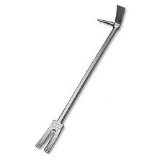
What is the name of this?
Where can it be located?
How do you use it and in what scenarios can it be used?
Any safety precautions?
Maintenance?

Slide 7
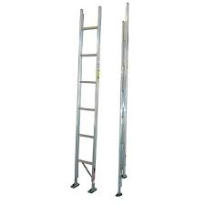
What is the name of this?
Where can it be located?
How do you use it and in what scenarios can it be used?
Any safety precautions?
Maintenance?

Slide 8
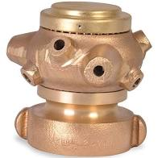
What is the name of this?
Where can it be located?
How do you use it and in what scenarios can it be used?
Any safety precautions?
Maintenance?

Slide 9
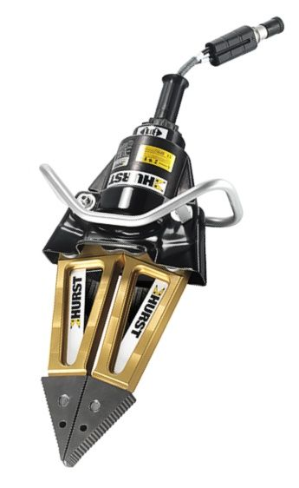
What is the name of this?
Where can it be located?
How do you use it and in what scenarios can it be used?
Any safety precautions?
Maintenance?

Slide 10
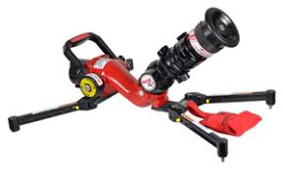
What is the name of this?
Where can it be located?
How do you use it and in what scenarios can it be used?
Any safety precautions?
Maintenance?

Slide 11
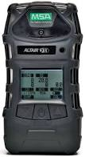
What is the name of this?
Where can it be located?
How do you use it and in what scenarios can it be used?
Any safety precautions?
Maintenance?

Slide 12
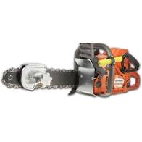
What is the name of this?
Where can it be located?
How do you use it and in what scenarios can it be used?
Any safety precautions?
Maintenance?

Slide 13
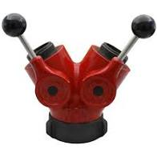
What is the name of this?
Where can it be located?
How do you use it and in what scenarios can it be used?
Any safety precautions?
Maintenance?

Slide 14
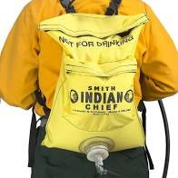
What is the name of this?
Where can it be located?
How do you use it and in what scenarios can it be used?
Any safety precautions?
Maintenance?

Slide 15
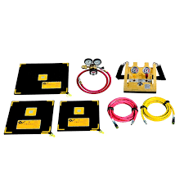
What is the name of this?
Where can it be located?
How do you use it and in what scenarios can it be used?
Any safety precautions?
Maintenance?

Slide 16
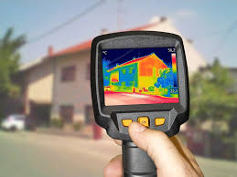
What is the name of this?
Where can it be located?
How do you use it and in what scenarios can it be used?
Any safety precautions?
Maintenance?

Slide 17
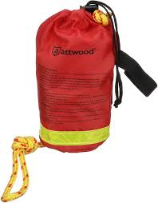
What is the name of this?
Where can it be located?
How do you use it and in what scenarios can it be used?
Any safety precautions?
Maintenance?

Slide 18
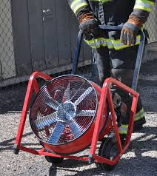
What is the name of this?
Where can it be located?
How do you use it and in what scenarios can it be used?
Any safety precautions?
Maintenance?

Slide 19
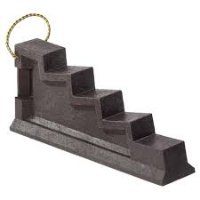
What is the name of this?
Where can it be located?
How do you use it and in what scenarios can it be used?
Any safety precautions?
Maintenance?

Slide 20
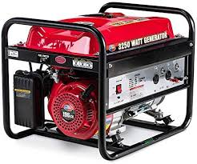
What is the name of this?
Where can it be located?
How do you use it and in what scenarios can it be used?
Any safety precautions?
Maintenance?

